Slide 1
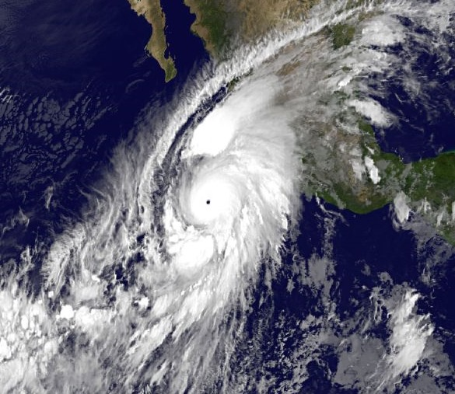
Potential Vorticity Aspects of Tropical Dynamics
Wayne Schubert
Colorado State University
2017 Bernhard Haurwitz
Memorial Lecture
21st Conference on Atmospheric and Oceanic Fluid Dynamics
Portland, OR June 28, 2017

Slide 2
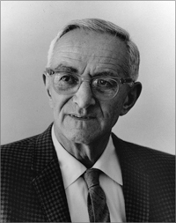
Bernhard Haurwitz (1905 – 1986)
Born: Aug. 14, 1905 (Glogau, Germany)
Died: Feb. 22, 1986 (Fort Collins, CO)
PhD: 1927, Univ. of Leipzig
1927–1932: Univ. of Leipzig
1932–1935: MIT & Blue Hill Observatory
1935–1941: Univ. of Toronto & Canadian Met.
1941–1947: MIT & Blue Hill Observatory
1947–1959: NYU & Woods Hole
1959–1964: Univ. of Colorado & HAO
1964–1976: NCAR & Univ. of Alaska - Fairbanks
1973–1986: CSU & Univ. of Alaska - Fairbanks
(from AIP Physics History Network website)

Slide 3
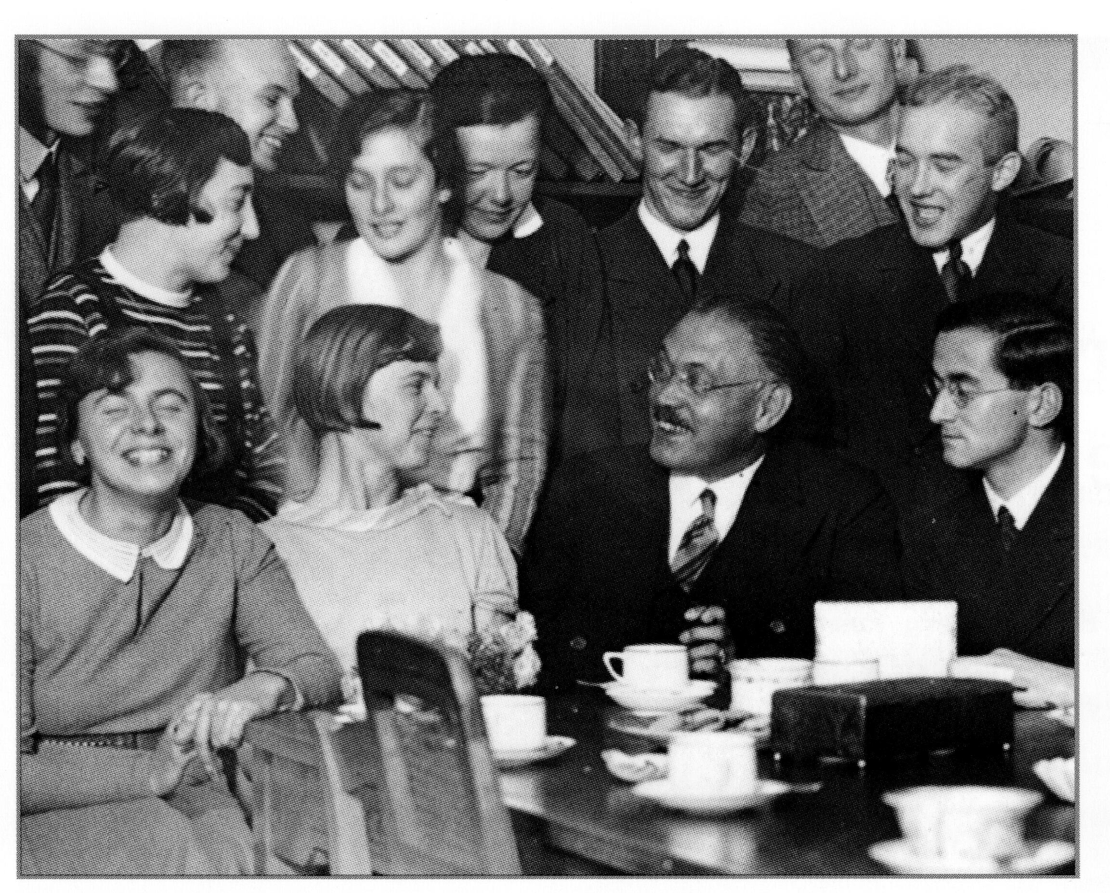
Bernhard Haurwitz: 1932
Farewell party at the University of Leipzig before leaving for the US
Invited to MIT by Rossby for what was originally planned to be a brief 7-month visit to the US
(from the book Geophysics and Meteorology at the University of Leipzig)

Slide 4
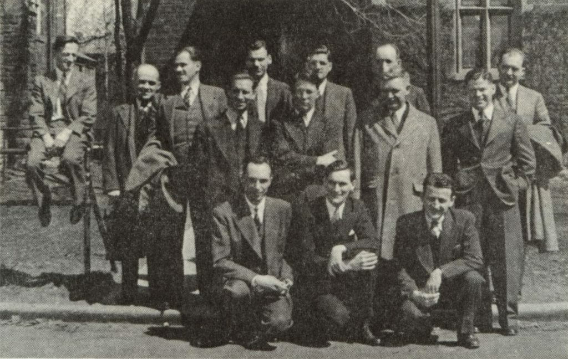
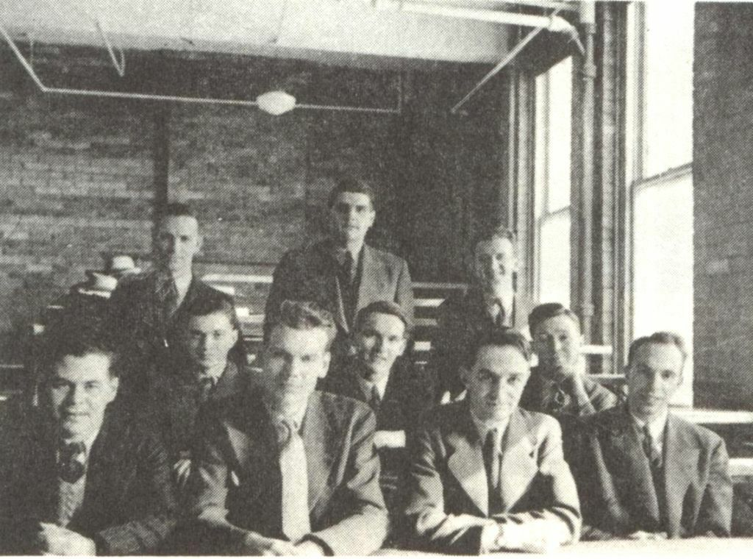
Bernhard Haurwitz: 1941
Teaching meteorology at the University of Toronto
(from the Canadian Meteorological and Oceanographic Society Archives website)

Slide 5

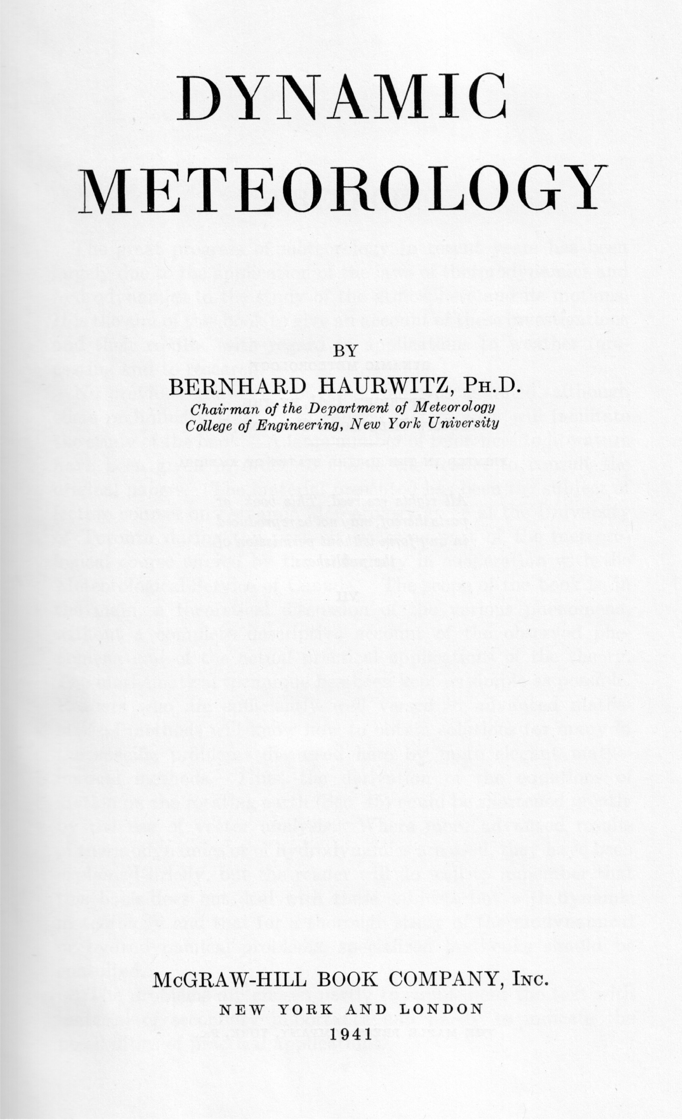
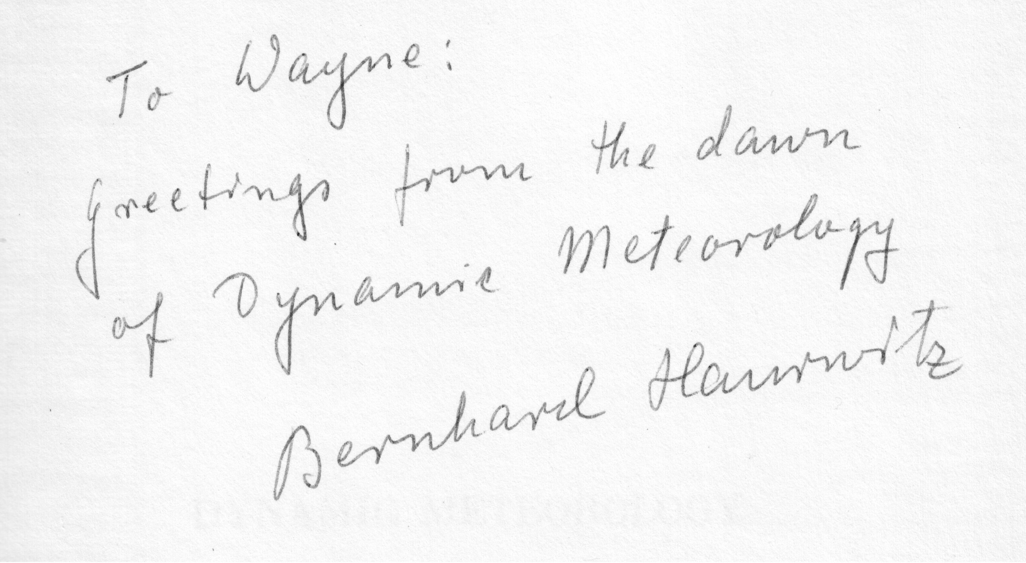
Textbook on Dynamic Meteorology: 1941
Inscription from Bernhard in my copy:

Slide 6

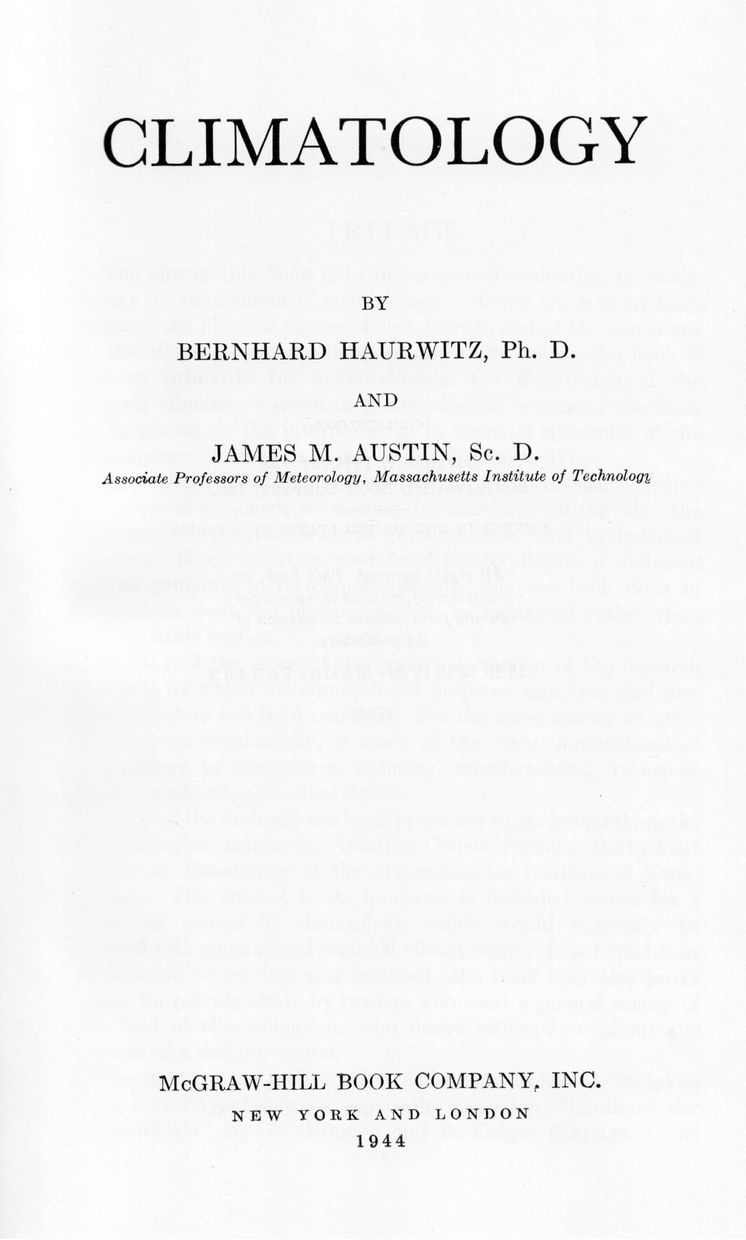
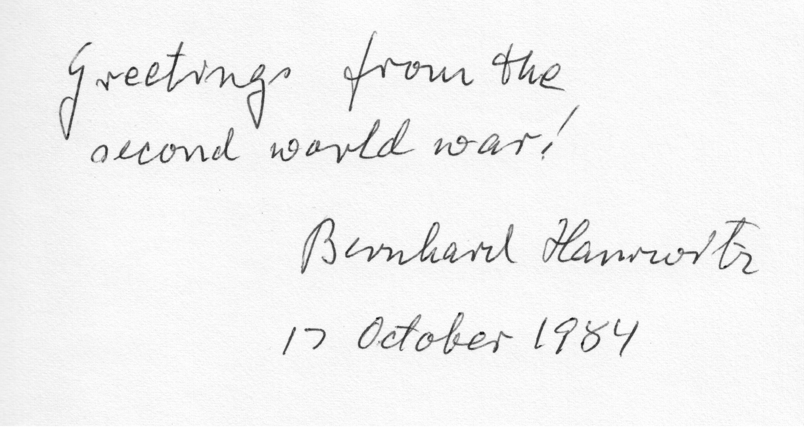
Textbook on Climatology: 1944
Inscription from Bernhard in my copy:

Slide 7
Textbook on Climatology: 1944
Quotes from Bernhard:
This book was written “because I had to give a course on the subject at MIT.”
“Because of my abysmal ignorance of synoptic meteorology, I invited Austin to coauthor the book.”
“… the climatology of the upper atmosphere will expand considerably in the future.”

Slide 8
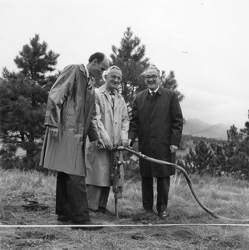
Bernhard Haurwitz: 1968
“Three men standing in a field holding a jack-hammer”
Breaking ground for the Fleischmann Building in Sept. 1968
Left to Right:
John Firor, NCAR Director
Bernhard Haurwitz, Director of ASP
Walter Orr Roberts, UCAR President
(from the UCAR website)

Slide 9
Chronology of the Theory of Planetary Waves:
Regional Planetary Waves ( -Plane) | Global Planetary Waves (Sphere)
 | Laplace (1799) Margules (1892,1893a,b) Hough (1897,1898)
Ekman (1923, 1932) Bjerknes (1937) Rossby (1939, 1940)
Haurwitz (1937, 1940a) | Haurwitz (1940b)
Longuet-Higgins (1964, 1965)
Matsuno (1966)
 | Longuet-Higgins (1968) Swarztrauber & Kasahara (1985)
(expanded from chronology presented by Platzman, 1968)

Slide 10
Rossby – Haurwitz Waves:
Model | Dispersion Relation | Eigenfunctions
Nondivergent Barotropic -plane, y-independent Rossby (1939)

Slide 11
Rossby – Haurwitz Waves:
Model | Dispersion Relation | Eigenfunctions
Nondivergent Barotropic -plane, y-independent Rossby (1939)
Nondivergent Barotropic -plane, zonal channel Haurwitz (1940a)

Slide 12
Rossby – Haurwitz Waves:
Model | Dispersion Relation | Eigenfunctions
Nondivergent Barotropic -plane, y-independent Rossby (1939)
Nondivergent Barotropic -plane, zonal channel Haurwitz (1940a)
Nondivergent Barotropic Sphere Haurwitz (1940b)

Slide 13
Rossby – Haurwitz Waves:
Model | Dispersion Relation | Eigenfunctions
Nondivergent Barotropic -plane, y-independent Rossby (1939)
Nondivergent Barotropic -plane, zonal channel Haurwitz (1940a)
Nondivergent Barotropic Sphere Haurwitz (1940b)
Shallow Water Sphere, local linear balance: |  | (Spheroidal Harmonics)

Slide 14
Haurwitz’ Interest in Tropical Cyclones:
Motion of binary tropical cyclones
One of first efforts at TC track prediction using simple barotropic arguments
Height of tropical cyclones and the eye
Used hydrostatic arguments to show that the circulation must extend up to at least 10 km
Ekman layer under curved air currents
“I wanted to find an explanation why the hurricane has an eye. I had in mind that there should be something which comes directly out of the hydrodynamic equations, which tells you that the influx into the hurricane in the outer part has got to stop somewhere.”

Slide 15
Introductory Thoughts on TC’s and PV
Ooyama (1982) described a tropical cyclone as …
    A mesoscale (~ 100 km) power plant
    With a synoptic scale (~ 1000 km) supportive system
TC track forecasting requires accurate modeling of the synoptic scale supportive system
TC intensity forecasting requires accurate modeling of the mesoscale power plant (more difficult)

Slide 16
Introductory Thoughts on TC’s and PV
Useful idealization:
The TC vortex is essentially a balanced, PV phenomenon
  Balanced wind and mass fields are invertible from the PV field
  The PV is far from being materially conserved
  Frictional effects are confined primarily to a shallow boundary layer
  The evolution of PV above that layer is determined by advection and diabatic effects

Slide 17
Foundational Quantities for Understanding PV:
Vector velocity:
Relative vorticity:
Absolute vorticity:
Potential temperature:
where
First Law:
for adiabatic flow

Slide 18
Potential Vorticity (PV):
Definition:
Note that PV is a scalar!
Creative concept:
  PV considers only the part of the absolute vorticity ⏊ to -surfaces
  PV ignores the part of the absolute vorticity parallel to -surfaces
Standard units:

Slide 19
Conservation of PV:
For inviscid, adiabatic flows:
  For example: synoptic scale mid-latitude flows above the boundary layer
For inviscid flows:
  For example: hurricanes, the ITCZ, and the MJO above the boundary layer

Slide 20
PV Invertibility Principle:
Note:
Assume hydrostatic balance:
Assume geostrophic or gradient balance:
Then:
(PV equals a 2nd-order operator on pressure)
Key Idea:
If we know PV, we can invert it to find pressure and hence both the wind and mass fields.

Slide 21
PV Invertibility Principle Example:
Cross section of a cyclone resulting from a PV anomaly
Winds:
  color contours
  every 4 m/s
Potential Temp:
  contour lines
  every 4 K
(from Masarik and Schubert, 2013)

Slide 22
Formation of Hollow PV Towers
Peak PV values of > 250 PVU
(from Hausman et al., 2006)

Slide 23
Hurricane
Patricia
23 Oct 2015, 1700 – 1800 UTC
Reconstruction of PV from SAMURAI analysis using dropsonde and Doppler radar data
(from Martinez, Bell, Rogers, and Doyle, 2017, in preparation)

Slide 24
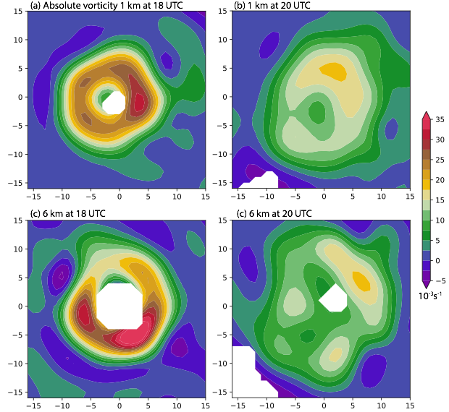
Hurricane
Patricia
18 UTC
20 UTC
1 km
23 Oct 2015
Horizontal cross sections of absolute vorticity at
  2 levels: 1 and 6 km
  2 times: 18 and 20 UTC
6 km
(from Martinez, Bell, Rogers, and Doyle, 2017, in preparation)

Slide 25
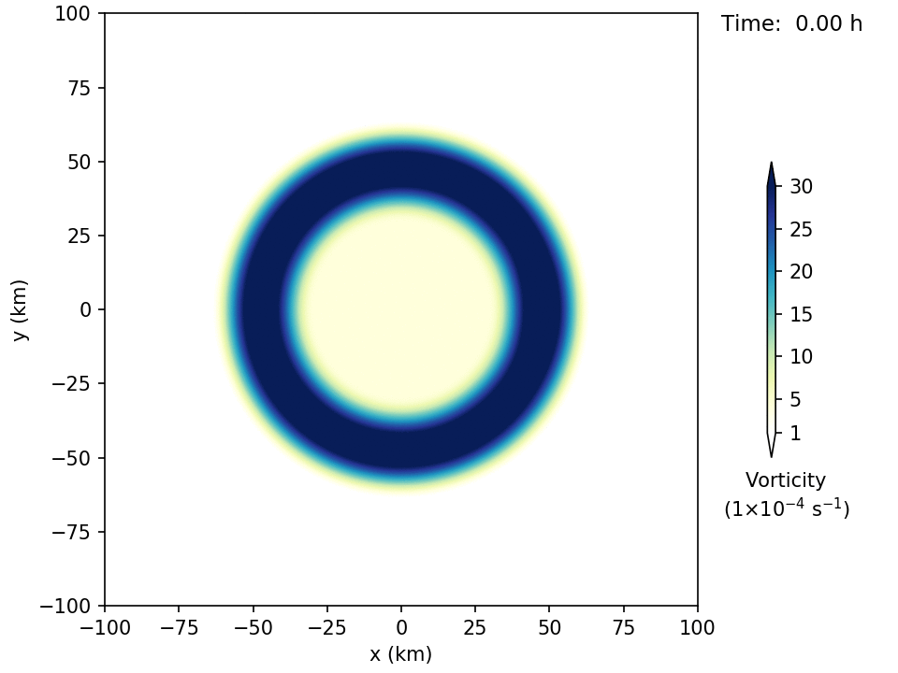
Breakdown of a Ring of Vorticity
Model results from a 4th-order nondivergent barotropic model

Slide 26
PV Equation:
Consider axisymmetric, inviscid flow on an -plane
PV equation expressed in cylindrical coordinates:
where
Potential radius defined in terms of the absolute angular momentum:

Slide 27
Simplification of the PV Equation:
Coordinate transformation:
where
Material derivative:
where is the rate that fluid particles cross -surfaces
For inviscid axisymmetric flow:
Simplified PV equation:

Slide 28
PV Dynamics in Characteristic Form:
Simplified PV equation can be written in characteristic form:
Derivative along a characteristic:
Significant simplification:
1 PDE reduced to 2 ODE’s that can be solved in succession
For a given diabatic heating :
    1st ODE: gives the variation of PV along a characteristic
    2nd ODE: gives the shape of the characteristic

Slide 29
Useful Example:
Assume the diabatic heating is independent of and has the separable form:
where is a specified function
Set boundary isentropes:
Max value of diabatic heating occurs on the surface
    Reasonable for mean tropical atmosphere
    Not as reasonable for the warm core of an intense TC
This example most applicable to early formation of PV tower

Slide 30
Useful Example: Characteristics
Equation for characteristics:
where
is a dimensionless convective clock:
    Runs at different rates on different -surfaces
    -clock advances quickly in the eyewall where is large
    -clock advances slowly (or not at all) in the eye / far-field where is small or even zero

Slide 31
Useful Example: Characteristics
Equation for characteristics:
integrate
where is the initial potential temperature of a characteristic and serves as a label for the characteristic

Slide 32
Useful Example: PV along Characteristics
Assume initial PV is the constant
Equation for PV along a characteristic:

Slide 33
Useful Example:
Results
0.25
0.5
0.75
Characteristics plotted in orange
Isolines of shown in blue and labeled
Note that the clock runs fastest in the eyewall and slower in the eye and far-field
1
2
3
4
5
10

Slide 34
Further Insight:
Consider:
where
is max value of
is potential radius where this max value occurs
Then:
and
where

Slide 35
Further Insight: Results
1/4
1/2
1
1
2
0.9
4
0.2
0.1

Slide 36
Further Insight: Results
1/4
1/2
1
1
2
0.9
4
0.2
8
0.1
16

Slide 37
Further Insight: Results
1/4
1/2
1
1
2
4
0.9
8
0.2
16
0.1
32
64

Slide 38
Instability of PV Rings
The development of a hollow tower of PV creates the necessary conditions for combined barotropic-baroclinic instability
Such instabilities can lead to polygonal eyewalls, mesovorticies, and a significant rearrangement of PV within the TC
The instability of PV rings has been studied over the last two decades using a hierarchy of models:
    Nondivergent and divergent barotropic models
    3-dimensional hydrostatic models
    3-dimensional non-hydrostatic, full-physics models

Slide 39
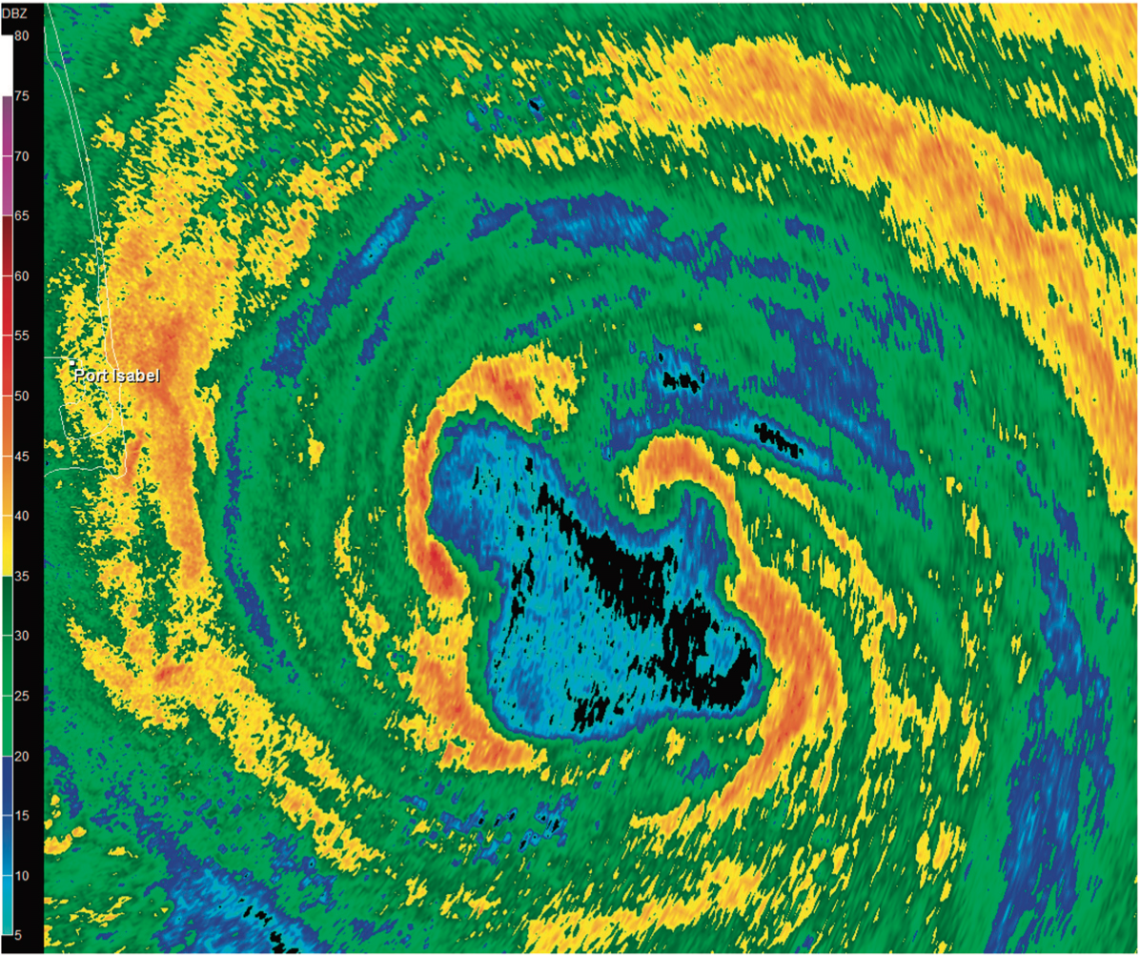
Hurricane Dolly
23 July 2008 1052 UTC
Base reflectivity from Brownsville, Texas, NWS radar
Note asymmetries (mesovorticies and straight line segments) in the inner core
(from Hendricks et al., 2009)

Slide 40
Simple Linear Stability Analysis
Annular ring of vorticity:
Note:
vorticity
radius
Thickness:
0 (thick) 1 (thin)
Hollowness:
0 (hollow) 1 (filled)

Slide 41
Simple Linear Stability Analysis
Isolines of maximum dimensionless growth rate for tangential wavenumbers m = 3, 4, …, 8
Shading indicates the wavenumber associated with the maximum dimensionless growth rate at each point
Note that thin, hollow rings are the most unstable
8
7
6
5
m = 4
m = 3
0.1
0.3
0.2
(adapted from Schubert et al., 1999)

Slide 42
Results from a Nondivergent Barotropic Model
(adapted from Schubert et al., 1999)

Slide 43
Warm Rings, Moats, and Hub Clouds
Schematic diagram of the eye of Hurricane Edna
9 - 10 September 1954
(adapted from Simpson and Starrett, 1955)

Slide 44
Typhoon Ida
U-2 photograph looking down from the lower stratosphere
25 September 1958
Note the presence and location of moats
(adapted from Fletcher et al., 1961)

Slide 45
Hurricane Cleo
August 1958
Cross-section of temperature anomaly
3-aircraft traversal
Note the warm ring in the inner core
(adapted from LaSeur and Hawkins, 1963)

Slide 46
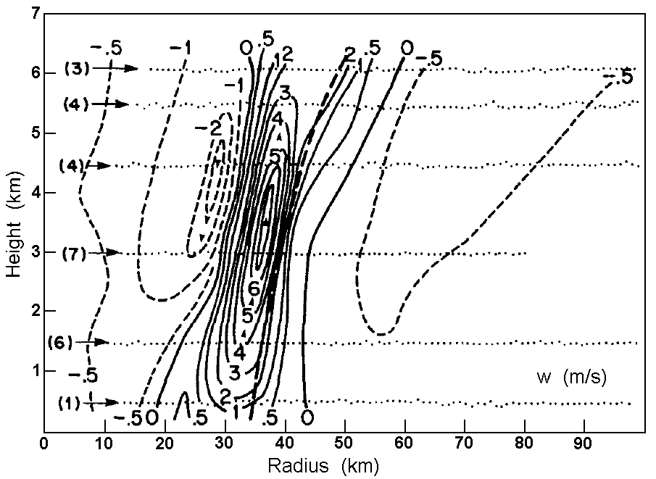
Hurricane Allen
5 Aug 1980
Isolines of physical-space vertical velocity
Note strongest downdrafts just inside eyewall
(adapted from Jorgensen, 1984)

Slide 47

Hub Cloud in Eye of Hurricane Isabel
Far Eyewall Convection
Hub Cloud (top at ~ 3 km)
13 Sep 2003
Moat
(courtesy of Sim Aberson)

Slide 48
Hurricane Isabel
Radial profiles of NOAA WP-3D aircraft data (13 Sep 2003)
2.1 km Altitude (1922 – 1931 UTC)
3.7 km Altitude (1948 – 1956 UTC)
(adapted from Schubert et al., 2007)

Slide 49
Model for the Subsidence in the Eye
Consider axisymmetric, balanced flow of an inviscid fluid lying above the frictional boundary layer
Transverse circulation equation (TCE): 2nd order PDE for
      Assume baroclinicity is 0 and static stability is
      Assume separable forms for
Simplified TCE: 2nd order ODE for
      In the eye: ODE becomes homogeneous
      Set local Rossby length to the constant “core value”
Modified Bessel equation: 2nd order ODE for

Slide 50
Subsidence in the Eye
Normalized Vertical Motion
Modified Bessel equation:
for
solve
Normalized vertical motion in the eye:

Slide 51
The Tropical Cyclone Boundary Layer
A hollow PV tower will be produced if is confined to an annular region
What dynamical process produces such a confinement?
The nonlinear, frictional boundary layer dynamics of strong vortices appears to play an important role:
    Annular boundary layer shocks can develop
    Such shocks lead to very intense boundary layer pumping
    This creates large in the overlying fluid
Simple models of the axisymmetric slab boundary layer under a specified pressure field provide valuable insight

Slide 52
Hurricane Hugo
Outbound (above BL)
15 Sep 1989
NOAA WP-3D aircraft data
Note the shock-like structure in the boundary layer
Tangential Wind
Inbound (in BL)
Radial Wind
Shock-like Structure in BL
Vertical Velocity
(from Williams et al., 2013)

Slide 53
Slab Boundary Layer Model for TCs (SBLM-TC)
Consider axisymmetric boundary layer flow on an -plane
Governing equations:
Note embedded Burgers’ equation
Forcing from overlying layer:

Slide 54
SBLM-TC Experiments
Parameters:
Forcing:
Gradient Wind in the Overlying Layer
Domain and discretization:
(from Williams et al., 2013)

Slide 55
SBLM-TC Experiments
C1
C3
C5
Radial Velocity
Note that shock-like structures quickly develop
C5
C3
C1
Tangential Velocity
(from Williams et al., 2013)

Slide 56
SBLM-TC Experiments
C5
Vertical Velocity
C3
C1
C5
Relative Vorticity
Note that shock-like structures quickly develop
C3
C1
(from Williams et al., 2013)

Slide 57
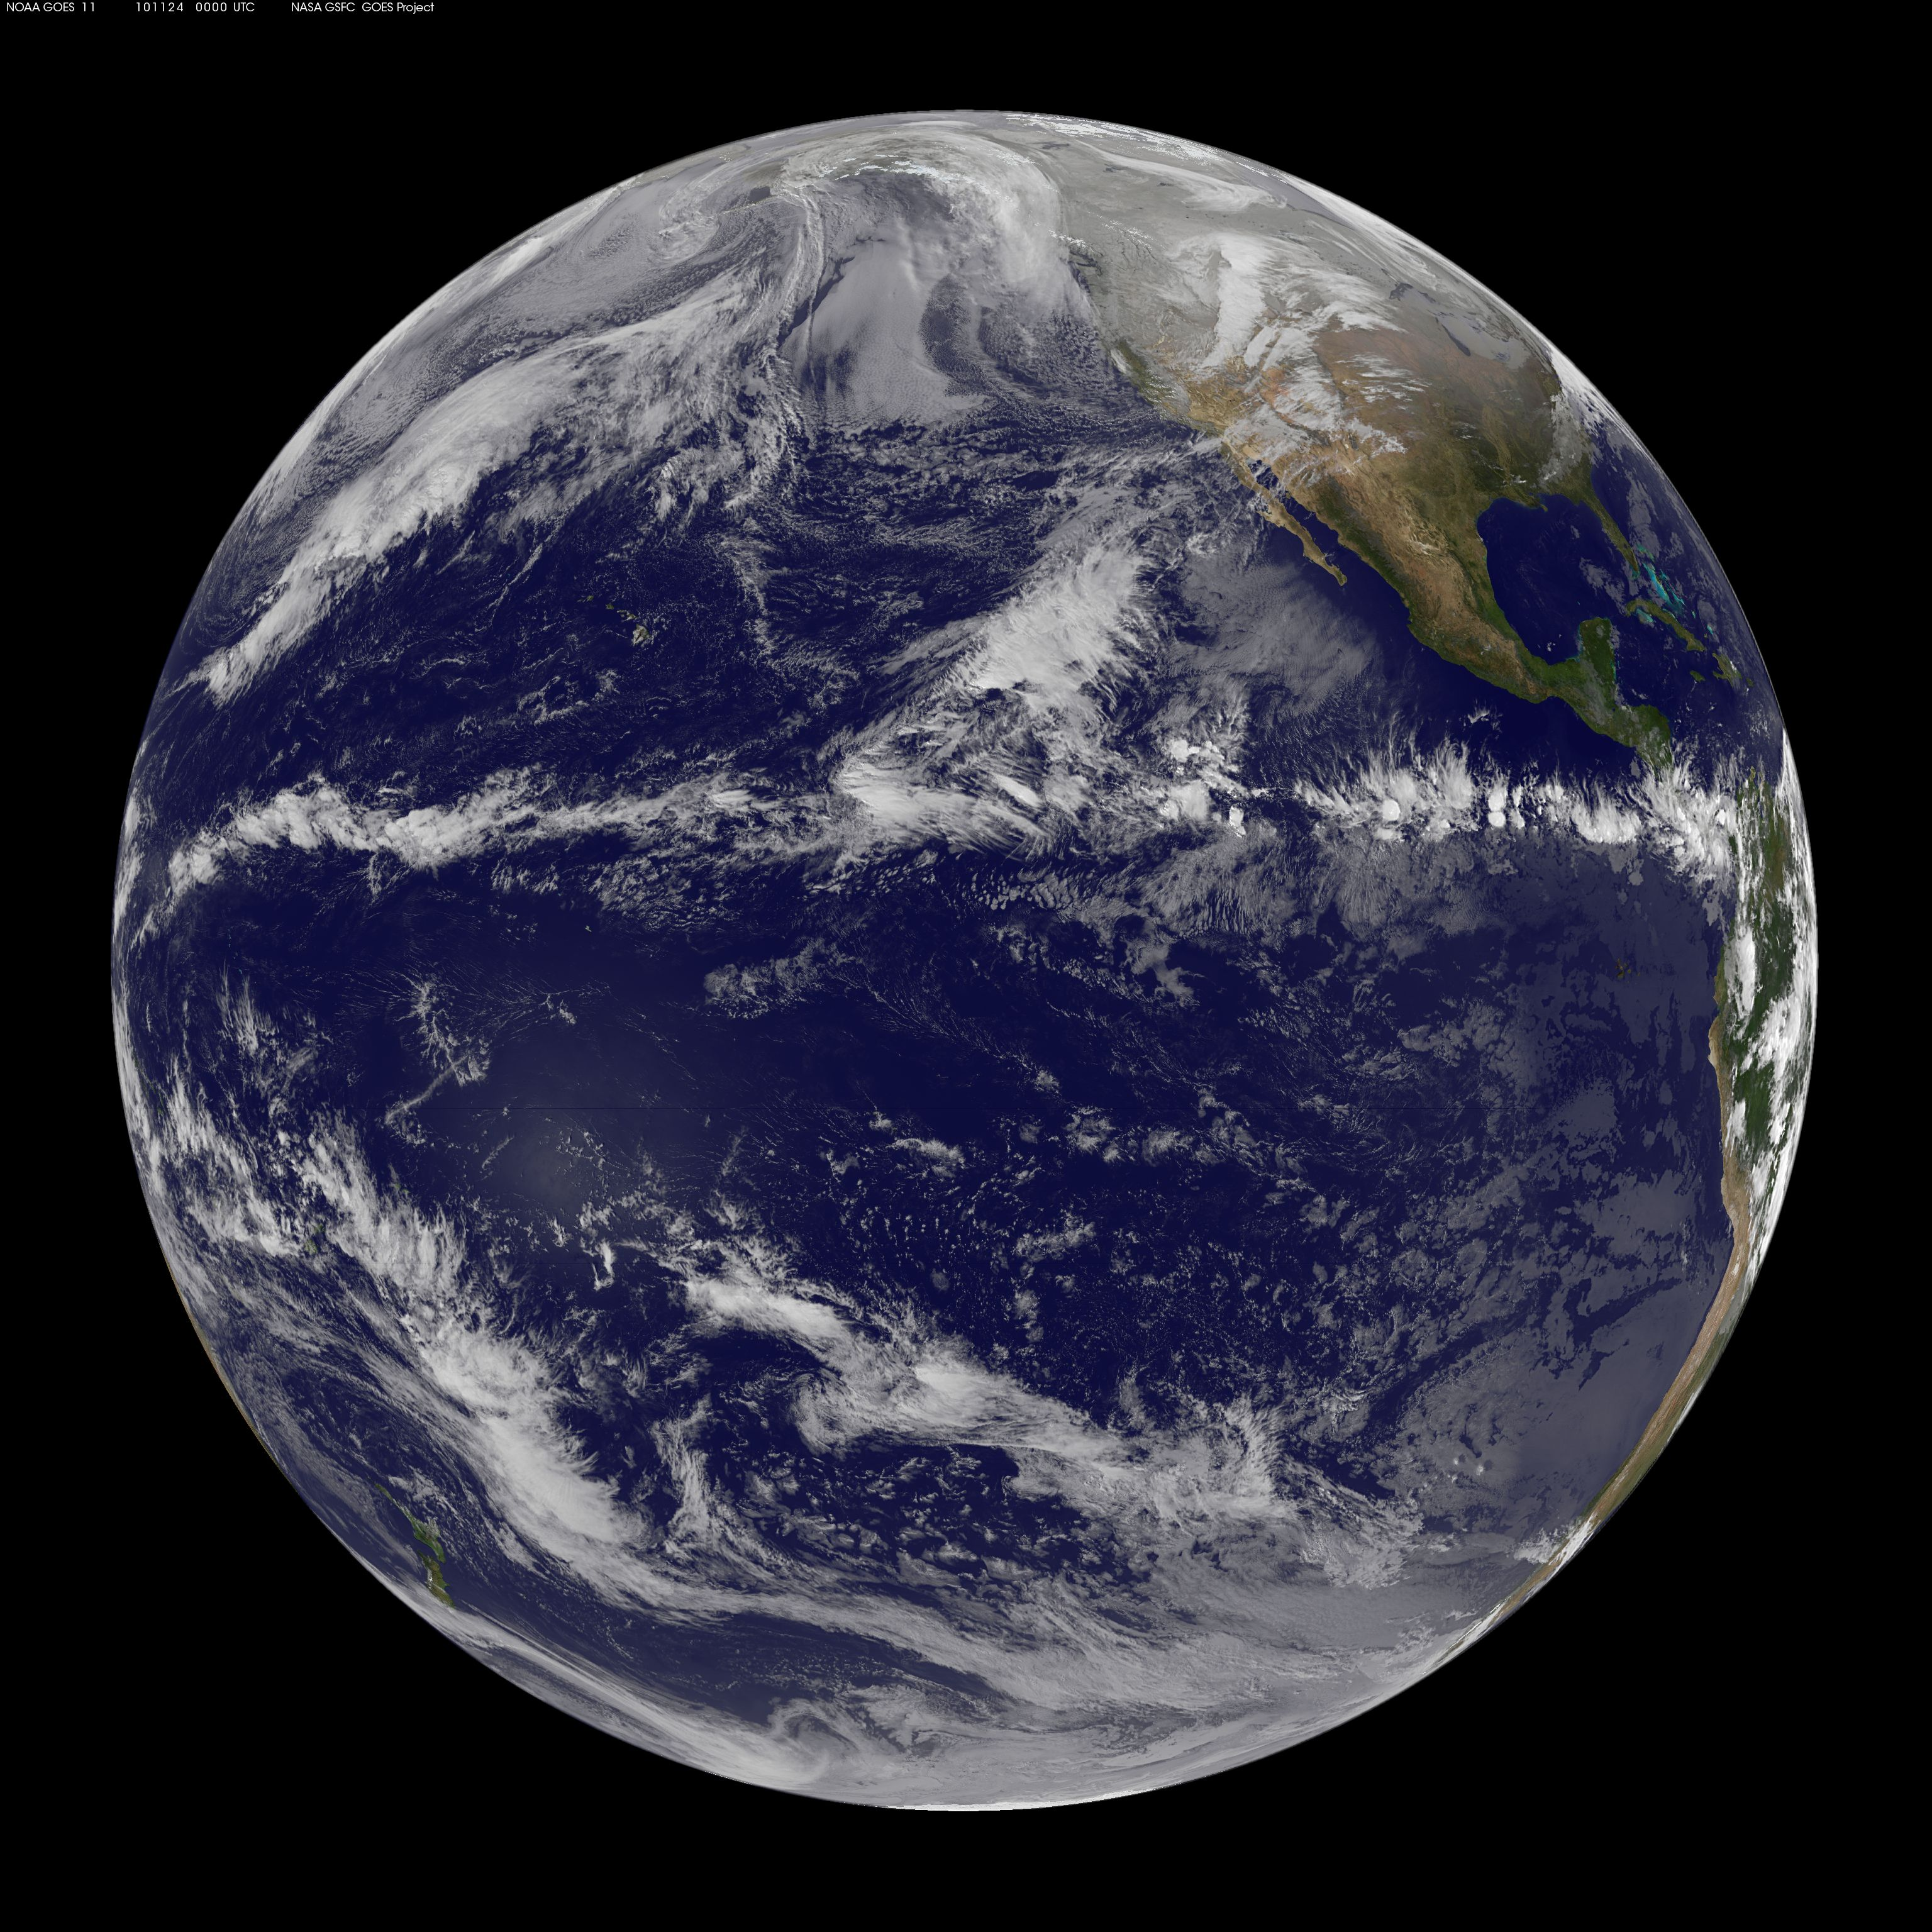
What About the ITCZ?
NOAA GOES 11 visible image at 00:00 UTC on 24 November 2010
On the surface, the ITCZ appears to be a very different phenomenon than a TC
But what about their PV dynamics?
(courtesy of NASA Goddard Space Flight Center)

Slide 58
What About the ITCZ?
As in a TC, there is transient inertia-gravity wave activity in the ITCZ
BUT, once again there is a useful idealization:
The ITCZ is essentially a balanced, PV phenomenon
  Balanced wind and mass fields are invertible from the PV field
  Frictional effects are confined primarily to a shallow boundary layer
  The evolution of PV above that layer is determined by advection and diabatic effects

Slide 59
PV Equation:
Consider zonally symmetric, inviscid flow on the sphere
PV equation expressed in latitude and height coordinates:
where
Potential latitude defined in terms of the absolute angular momentum:

Slide 60
Simplification of the PV Equation:
Coordinate transformation:
where
Material derivative:
where is the rate that fluid particles cross -surfaces
For inviscid zonally symmetric flow:
Simplified PV equation:
Exactly the same equation as in the TC case!

Slide 61
PV Dynamics in Characteristic Form:
Simplified PV equation can be written in characteristic form:
Derivative along a characteristic:
Significant simplification:
1 PDE reduced to 2 ODE’s that can be solved in succession
For a given diabatic heating :
    1st ODE: gives the variation of PV along a characteristic
    2nd ODE: gives the shape of the characteristic

Slide 62
Useful Example:
Assume the diabatic heating is independent of and has the separable form:
where is a specified function
Set boundary isentropes:
Max value of diabatic heating occurs on the surface
Produces PV anomalies that are entirely internal since vanishes at

Slide 63
Useful Example: Characteristics
Equation for characteristics:
where
is a dimensionless convective clock:
    Runs at different rates on different -surfaces
    -clock advances quickly near the center of the ITCZ
    -clock advances slowly near the edge of the ITCZ

Slide 64
Useful Example: Characteristics
Equation for characteristics:
integrate
where is the initial potential temperature of a characteristic and serves as a label for the characteristic

Slide 65
Useful Example: PV along Characteristics
Assume initial PV is where is a constant
Equation for PV along a characteristic:

Slide 66
Useful Example:
Results
1/4
Characteristics plotted in orange
Isolines of shown in blue (labeled)
Note that the clock runs fastest in the center of the ITCZ and slower near its edge
1/2
1
32
2
16
4
8

Slide 67
Further Insight:
Consider:
where
is max value of and controls its width
is potential latitude where this max value occurs
Then:
and
where

Slide 68
Further Insight: Results
0.1
1

Slide 69
Further Insight: Results
0.1
1

Slide 70
Further Insight: Results
0.1
1

Slide 71
Concluding Remarks
Older view presented by Charney and Eliassen (1964) and Charney (1971):
    Basic dynamics of both TCs and the ITCZ could be understood through linear stability analyses involving balanced models with parameterized convection
    For unstable disturbances, the primary circulation, the secondary circulation, and the diabatic heating all increase exponentially with time

Slide 72
Concluding Remarks
Modern view:
    Better understanding can be obtained through the analysis of the nonlinear aspects of the PV evolution
    Allows the primary circulation to increase exponentially in time while the diabatic heating is fixed
    Recognizes that the nonlinear dynamics of the boundary layer produces sharp, intense boundary layer pumping that dictates the position of the eyewall and size of the eye
Major challenge for future research:
    Improve intensity forecasting by improving numerical simulation of the TC’s mesoscale power plant

Slide 73
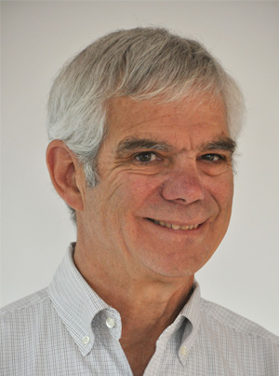
Be Sure to Attend Next Year’s
Bernhard Haurwitz Memorial Lecture
George Kiladis, NOAA ESRL
The Bernhard Haurwitz Memorial Lecturer for 2018
For influential observational studies of tropical-extratropical wave dynamics and leadership in the field of large-scale tropical meteorology

Slide 74
More Information
This PowerPoint presentation and a more detailed write-up of this presentation are available on the website for the Schubert Research Group at Colorado State University under “Presentations”
    http://schubert.atmos.colostate.edu/presentations/
    Or search for “CSU Schubert Research Group”
For more information about the life of Bernhard Haurwitz, there are several excellent sources listed on the above website

