Slide 1
Tropical cyclone inner core structure and intensity change
Kate D. Musgrave
PhD Defense, 10/28/2011

Slide 2
Acknowledgements
Advisors: Wayne Schubert and Chris Davis
Committee: Richard Johnson, David Thompson, Michael Kirby, and Russ Schumacher
Schubert Group and TC folks: Rick Taft, Brian McNoldy, Jonathan Vigh, Kate Maclay, Andrea Schumacher, John Knaff, and Mark DeMaria
Family and friends; Chris
Support from: SOARS, CMMAP, NSF, ONR, and HFIP

Slide 3
Outline
Background: tropical cyclone (TC) structure and intensity
Two projects examining aspects of the relationship between TC eyes and intensity:
  Aircraft Reconnaissance Measurements of Atlantic Tropical Cyclone Eyes
  Effects of Vortex Structure on the Diabatically-Induced Intensification of Tropical Cyclones
Summary
Future work

Slide 4
Background
TC intensity is dependent on the large-scale environment, the storm-scale dynamics, and the underlying ocean state
Numerous studies have attempted to investigate the relationship between TC structure and intensity
Results have been varied, but in general the closer the measure of structure is to the radius of maximum winds (RMW), the better the relationship to the intensity (Merrill 1984, Weatherford and Gray 1988b, Croxford and Barnes 2002)

Slide 5
TC Size, Strength and Intensity
Merrill (1984)

Slide 6
Eye Structure and Intensity
No direct relationship between eye diameter and intensity (Jordan 1961, Weatherford 1989)
Eye processes/configurations linked to intensity and intensity trend: (Shapiro and Willoughby 1982, Willoughby et al. 1982, Knaff et al. 2003, Schubert et al. 1999)
  Eye contraction and intensification
  Concentric eyewall cycles
  Annular hurricanes
  Elliptical and polygonal eyes
  “Pinhole” eyes

Slide 7
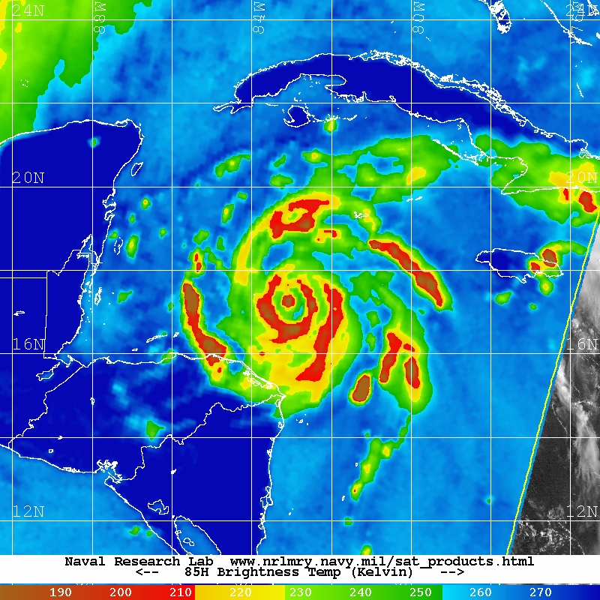
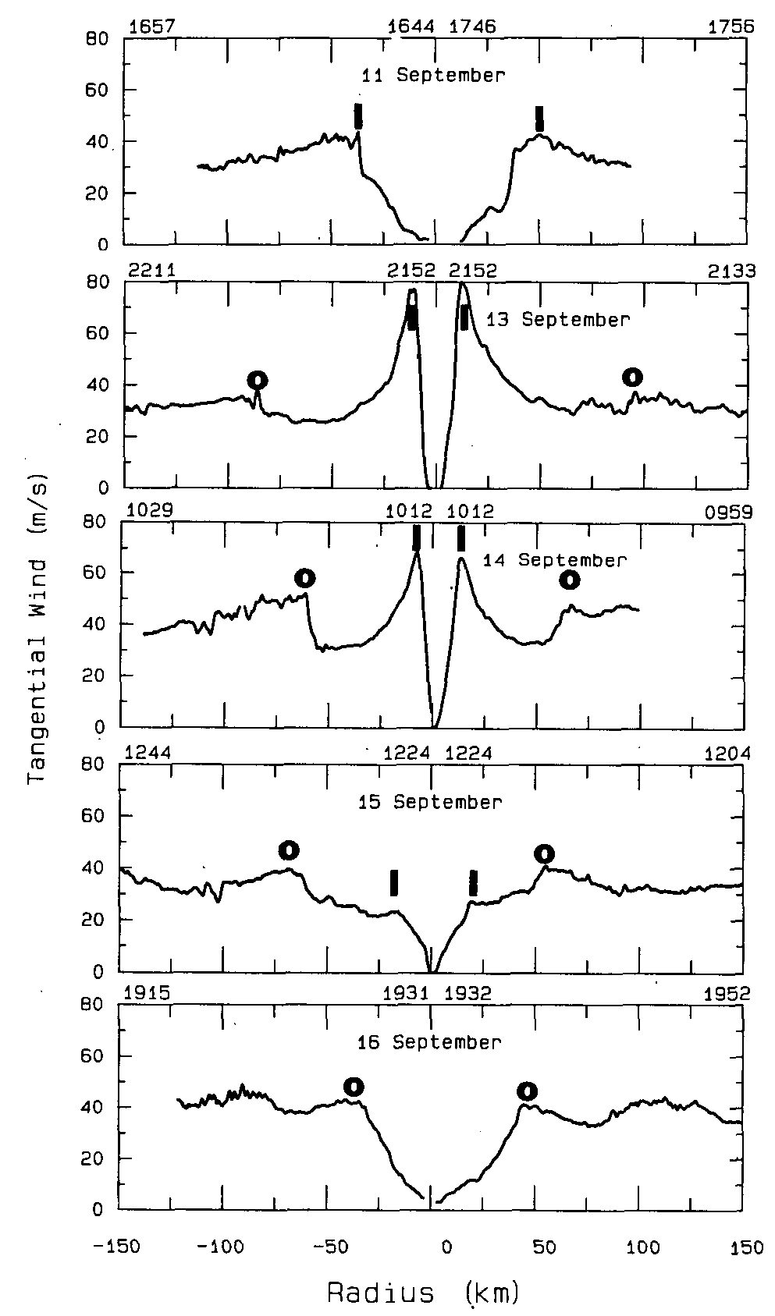
Concentric Eyewall Cycles
Wilma 2005
Gilbert 1988
Black and Willoughby (1992)

Slide 8
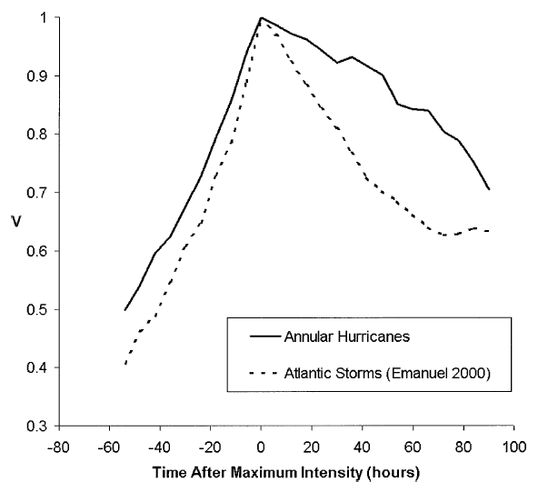
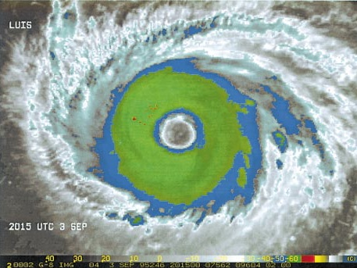
Annular Hurricanes
Knaff et al. (2003)

Slide 9
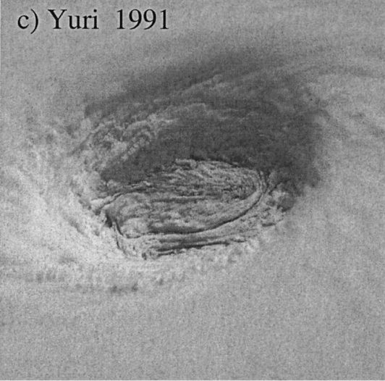
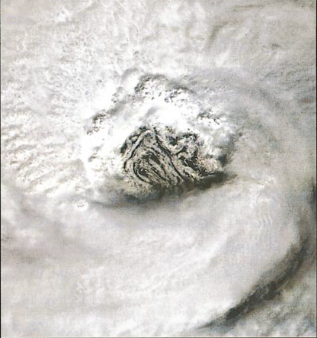
Elliptical and Polygonal Eyes
Eyes have long been observed to have periods when their shape is not a perfectly symmetric circle – at times resembling ellipses or polygons
Elliptical eyes have been observed to correspond with weaker TCs, often in the early or late stages of their lifecycle (Jordan 1961, Weatherford 1989)
Polygonal eyes have been associated with eyewall mesovortices and barotropic instability (Schubert et al. 1999, Kossin and Schubert 2001)
Erin 2001
Kossin et al. (2002)

Slide 10
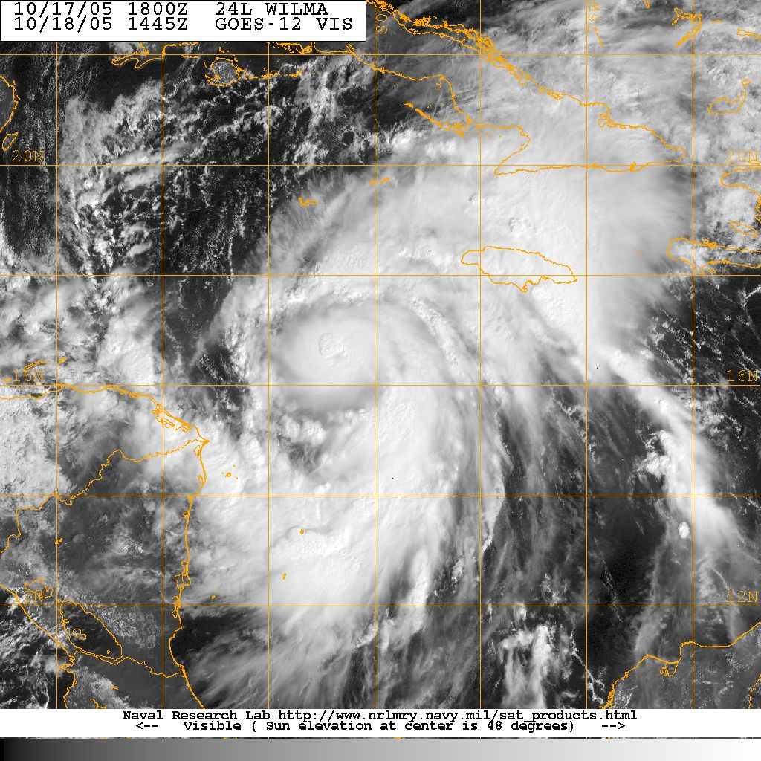
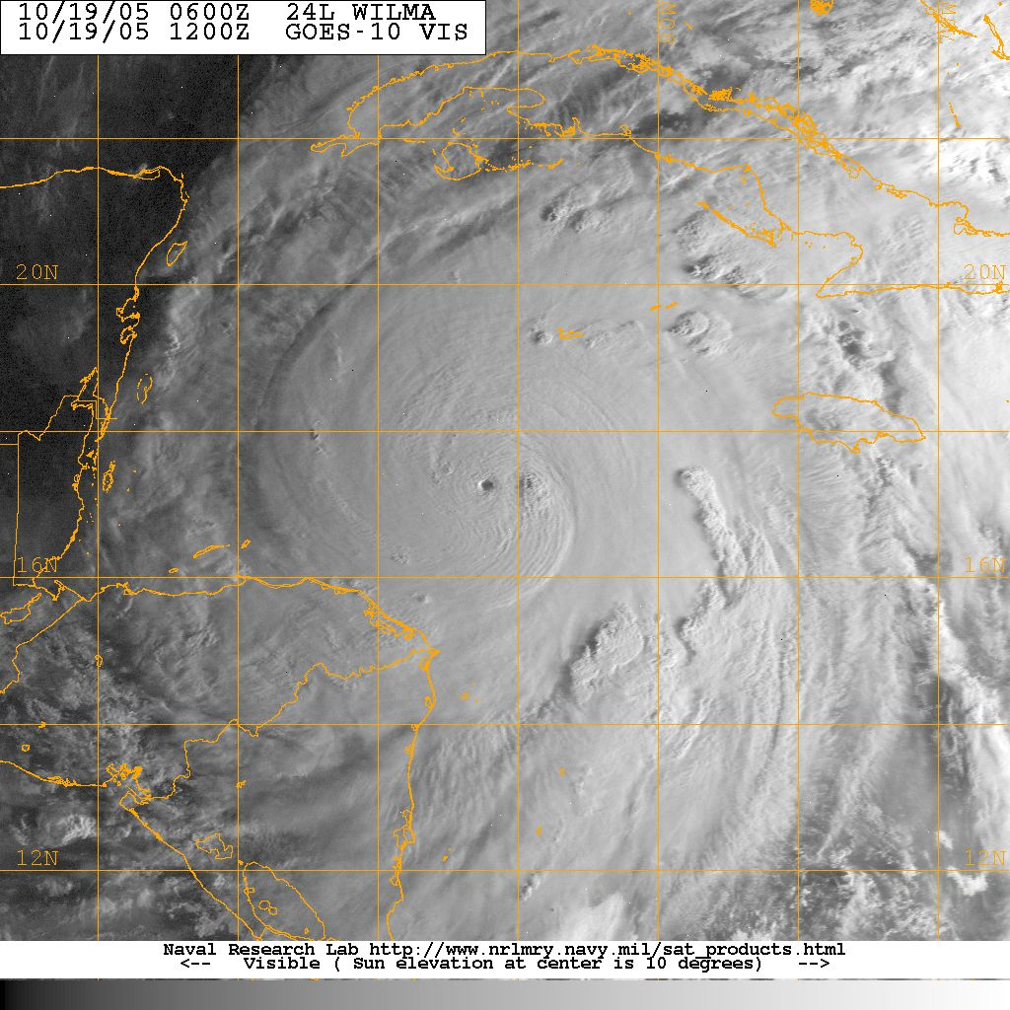
“Pinhole” Eyes

Slide 11
Atlantic TC Eye Estimates
Jordan (1961) and Weatherford (1989) looked at aircraft reconnaissance in the Northern West Pacific
Kimball and Mulekar (2004) looked at extended best track for the Atlantic basin
Combine the aircraft reconnaissance fixes, the best track, and the extended best track for Atlantic TCs over the period 1989-2008
Aircraft measures eye diameter (in nmi) and eye type (EL, CI, CO)
Look at TC eye behavior in relation to intensity and intensity change

Slide 12
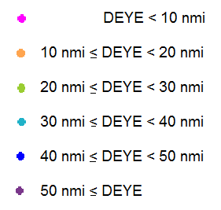
Aircraft Eye Estimates

Slide 13
Aircraft Eye Estimates
2279 Aircraft Eye Estimates
Median: 20 nmi
Mean: 23 nmi

Slide 14
TC Eye Estimates
109 TCs with eye estimates
1030 best track 6hr periods

Slide 15
Boxplots
(2279)

Slide 16
Eye Diameter by Type
(2279) (338) (1828) (104) (49) (49)

Slide 17
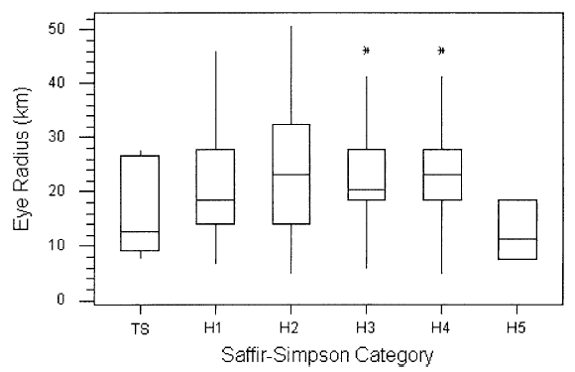
Eye Diameter and Intensity
Kimball and Mulekar (2004)
(2279) (198) (660) (469) (365) (500) (87)

Slide 18
Eye Diameter and Intensity
(2279) (154) (727) (718) (373) (191) (116)

Slide 19
Eye Type and Intensity
(2279) (338) (1828) (104)

Slide 20
Intensity Change
(2279) (154) (727) (718) (373) (191) (116)

Slide 21
Rapid Intensification
 | Best Track | Percent | Aircraft Eyes | Percent
RI – previous 24-48 hr | 513 | 5.5% | 152 | 14.8%
RI – currently underway | 690 | 7.4% | 212 | 20.6%
RI – initial time | 134 | 1.4% | 19 | 1.8%
RI – next 24 hr | 497 | 5.3% | 44 | 4.3%
 | 9353 total |  | 1030 total

Slide 22
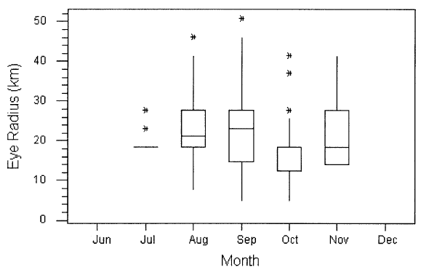
Eye Estimates by Month
Kimball and Mulekar (2004)
(0) (0) (1) (92) (299) (465) (135) (40) (0)

Slide 23
Eye Estimates by Month

Slide 24
Eye Estimates by Latitude
(1030) (48) (246) (288) (274) (144) (30)

Slide 25
Summary
No direct relationship between eye size and current intensity
Small eyes occur in all TC intensity categories, large eyes not observed in the weakest and strongest TCs
Small eyes have largest variability in intensity change, both increasing and decreasing intensity

Slide 26
Future Work
Combine with SHIPS dataset to examine large scale environment
Examine eye diameters in HURSAT for inclusion in eye diameter database, comparison with reconnaissance
Use reconnaissance flight level winds to calculate RMW, compare distance between edge of eye and RMW

Slide 27
TC Structure and Intensity Change: Balanced Vortex Model
Several studies have examined tropical cyclones using the balanced vortex model developed in Eliassen (1952)
Recently, Vigh and Schubert (2009) investigated the effects of diabatic heating (DH) inside and outside the radius of maximum winds (RMW) on intensification
The use of Rankine vortex profiles limited the vorticity to within the RMW, this project will investigate the effect of vorticity skirts on the efficiency of diabatic heating to intensify vortices

Slide 28
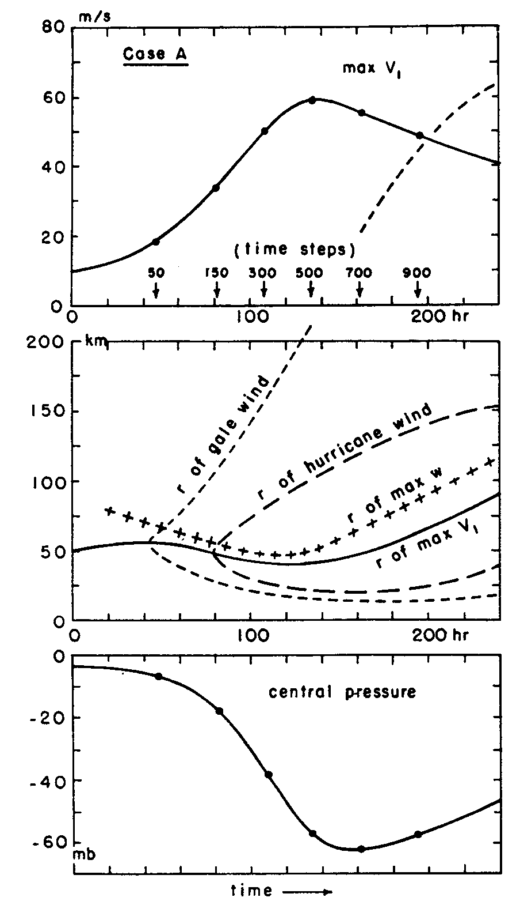
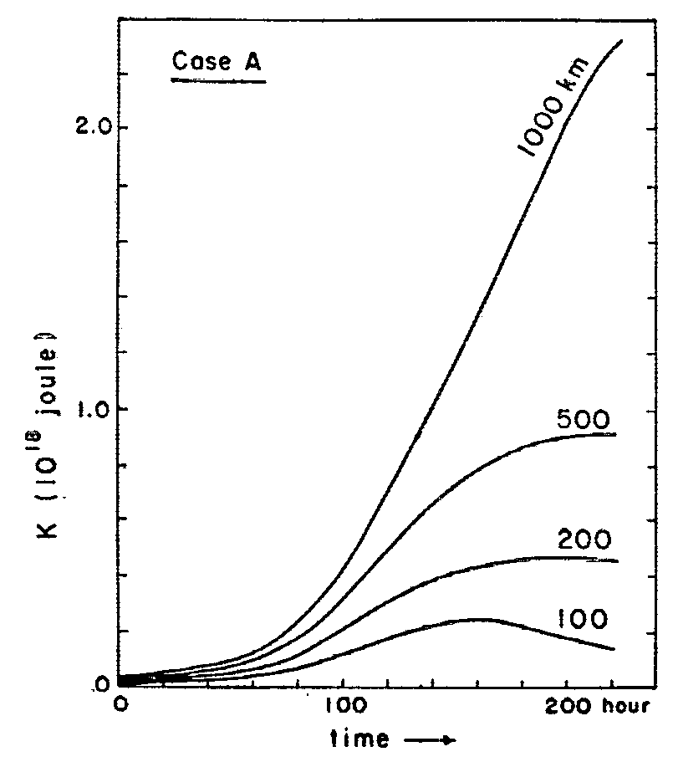
“Typical” Lifecycle
Ooyama (1969)

Slide 29
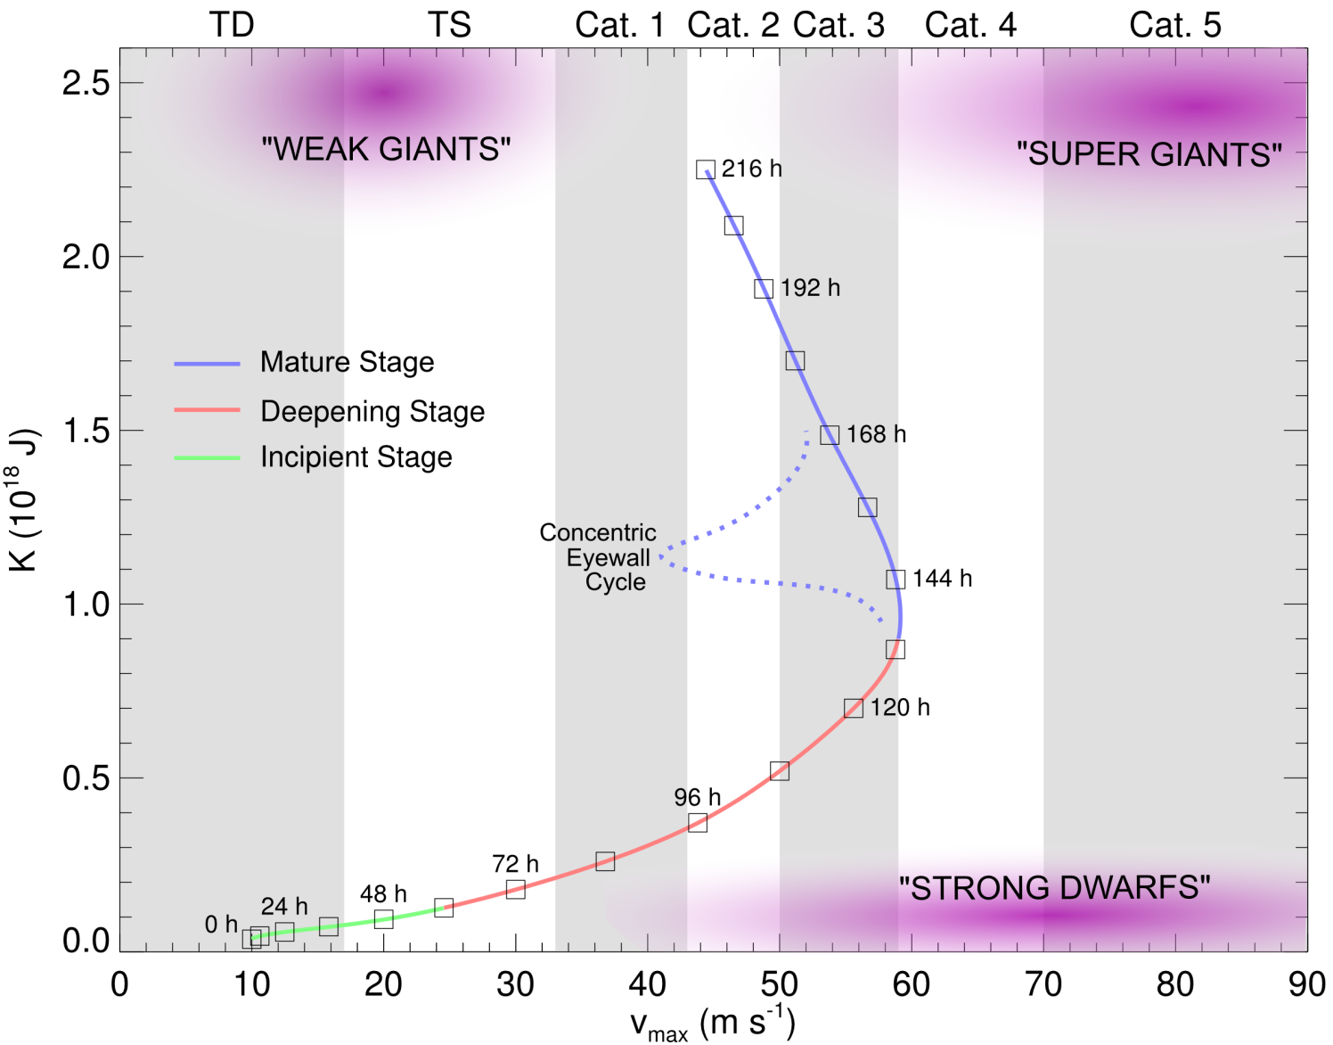
K-V_{max} Lifecycle

Slide 30

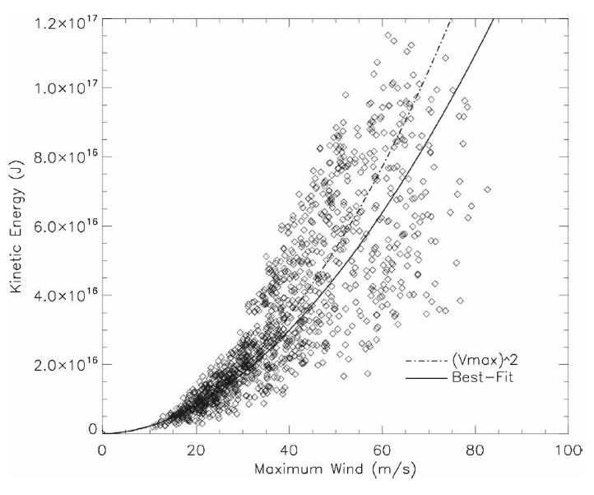
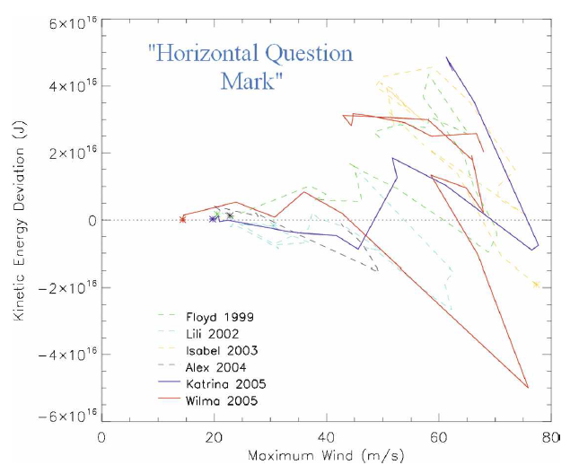
Aircraft Intensity and IKE
Maclay et al. (2008)

Slide 31
Balanced Vortex Model
We reduce the governing equations to:
Where the static stability is assumed to be constant and inertial stability a function of r only
To focus on the role of the inertial stability, we neglect the baroclinic terms

Slide 32
Tendency Equation
Instead of solving for the secondary circulation, solve for the geopotential tendency equation:
Solve the elliptic partial differential equation by separation of variables, assuming:

Slide 33
The Problem
Second-order boundary value problem
Need to specify radial distribution of Rossby length, ℓ
Need numerical solutions for complicated distributions of ℓ

Slide 34
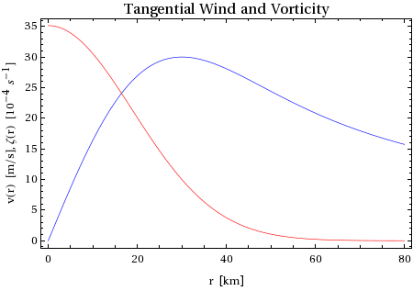
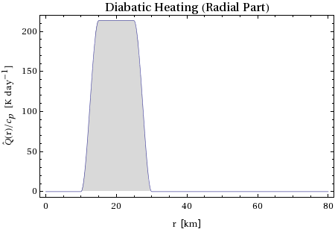
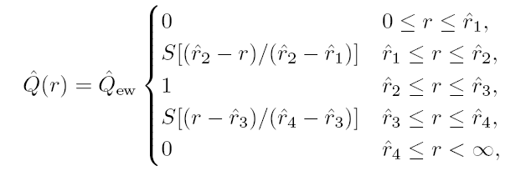

Vortex Profiles
Vortex profiles based off Gaussian vortex, controlled by RMW and V_{max}
  RMW = 30 km
  V_{max} = 30 ms⁻¹
DH profiles based on warm-ring profiles, uses additional four radii to control.
V_{max}
RMW

Slide 35
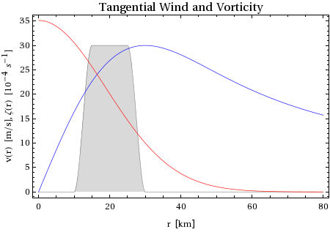
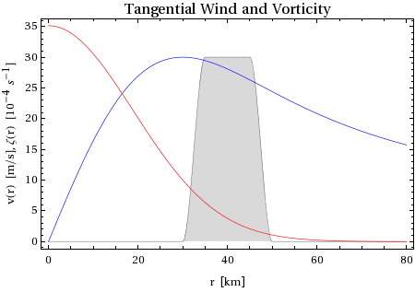
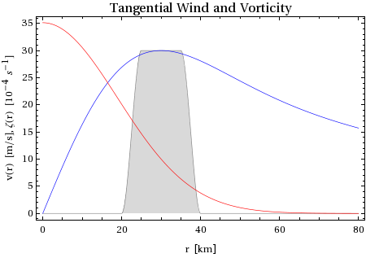
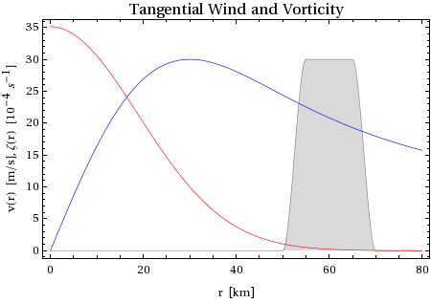
Initial Profiles
DH Inside RMW
DH Inside Skirt
RMW
RMW
DH Across RMW
DH Outside Skirt
RMW
RMW

Slide 36
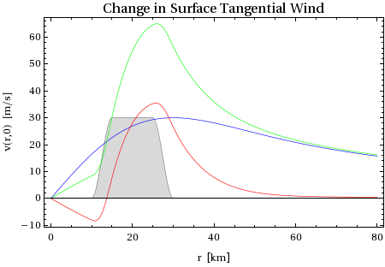
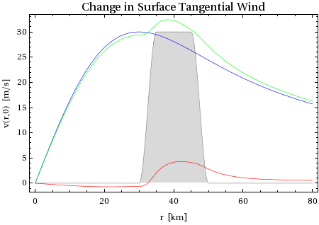
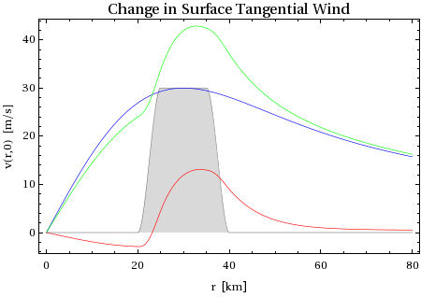
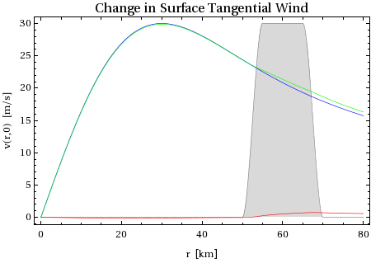
Results
DH Inside RMW
DH Inside Skirt
RMW
RMW
DH Across RMW
DH Outside Skirt
RMW
RMW

Slide 37
Results –
Tangential Wind Tendencies
The response is determined by the interaction of the diabatic heating with the vortex profile
  DH inside RMW produces most intense response and contracts RMW
  DH across RMW intensifies vortex, increases RMW
  DH inside vorticity skirt produces positive tangential wind tendency, but not separate from main peak
  DH outside vorticity skirt produces increase at inflow maximum, possible secondary wind maximum
RMW

Slide 38
Results –
Tangential Wind Tendencies
The response is determined by the interaction of the diabatic heating with the vortex profile
  DH inside RMW produces most intense response and contracts RMW
  DH across RMW intensifies vortex, increases RMW
  DH inside vorticity skirt produces positive tangential wind tendency, but not separate from main peak
  DH outside vorticity skirt produces increase at inflow maximum, possible secondary wind maximum
RMW

Slide 39
Results –
Tangential Wind Tendencies
The response is determined by the interaction of the diabatic heating with the vortex profile
  DH inside RMW produces most intense response and contracts RMW
  DH across RMW intensifies vortex, increases RMW
  DH inside vorticity skirt produces positive tangential wind tendency, but not separate from main peak
  DH outside vorticity skirt produces increase at inflow maximum, possible secondary wind maximum
RMW

Slide 40
Results –
Tangential Wind Tendencies
The response is determined by the interaction of the diabatic heating with the vortex profile
  DH inside RMW produces most intense response and contracts RMW
  DH across RMW intensifies vortex, increases RMW
  DH inside vorticity skirt produces positive tangential wind tendency, but not separate from main peak
  DH outside vorticity skirt produces increase at inflow maximum, possible secondary wind maximum
RMW

Slide 41
Kinetic Energy
(from Maclay et al. 2008:
1244 AL & EP recon cases)
When heating is inside or across the RMW, V_{max} increases more than the kinetic energy
(right side of curve)
When heating is outside the RMW, KE increases more than V_{max}
(left side of curve)
KE₂₀₀ vs V_{max}
(from Maclay et al. 2008:
1244 AL & EP recon cases)

Slide 42
Summary
The idealized TC is very sensitive to the placement of the heating relative to the vortex profile
Heating within RMW produces a sharp increase in intensity; within the skirt can also intensify vortex
Heating increased IKE in all cases – strength increased less than intensity inside RMW, approximately equal increases in strength and intensity in skirt, and strengthened without intensifying outside of skirt

Slide 43
Future Work
Introduce more complex heating and vortex profiles
Initialize balanced vortex model with profiles calculated from dynamical model fields (HWRF, GFDL)
Initialize balanced vortex model with profiles calculated from aircraft reconnaissance and satellite data

Slide 44
References
Black, M. L., and H. E. Willoughby, 1992: The concentric eyewall cycle of Hurricane Gilbert. Mon. Wea. Rev., 120, 947-957.
Cocks, S. B., and W. M. Gray, 2002: Variability of the outer wind profiles of western North Pacific typhoons: Classifications and techniques for analysis and forecasting. Mon. Wea. Rev., 130, 1989-2005.
Croxford, M., and G. M. Barnes, 2002: Inner core strength of Atlantic tropical cyclones. Mon. Wea. Rev., 130, 127-139.
DeMaria, M., M. Mainelli, L. K. Shay, J. A. Knaff, and J. Kaplan, 2005: Further improvements to the Statistical Hurricane Intensity Prediction Scheme (SHIPS). Wea. Forecasting, 20, 531-543.
Demuth, J., M. DeMaria, and J. A. Knaff, 2006: Improvement of advanced microwave sounder unit tropical cyclone intensity and size estimation algorithms. J. Appl. Meteor., 45, 1573-1581.
Eliassen, A., 1952: Slow thermally or frictionally controlled meridional circulation in a circular vortex. Astrophys. Norv., 5, 19-60.
Elsberry, R. L., and R. A. Stenger, 2008: Advances in understanding of tropical cyclone wind structure changes. Asia-Pac. J. Atmos. Sci., 44, 11-24.
Emanuel, K. A., 2000: A statistical analysis of tropical cyclone intensity. Mon. Wea. Rev., 128, 1139-1152.
Frank, W. M., 1977: The structure and energetic of the tropical cyclone I. Storm structure. Mon. Wea. Rev., 105, 1119-1135.
Hawkins, J. D., and Coauthors, 2006: Tropical cyclone multiple eyewall configurations. Extended Abstracts, 27th Conf. on Hurricanes and Tropical Meteorology, Monterey, CA, Amer. Met. Soc., 6B.1.
Houze, R. A., Jr., S. S. Chen, B. F. Smull, W.-C. Lee, and M. M. Bell, 2007: Hurricane intensity and eyewall replacement. Science, 315, 1235-1239.
Jordan, C. L., 1961: Marked changes in the characteristics of the eye of intense typhoons between the deepening and filling stages. J. Meteor., 18, 779-789.
Kaplan, J., and M. DeMaria, 2003: Large-scale characteristics of rapidly intensifying tropical cyclones in the North Atlantic basin. Wea. Forecasting, 18, 1093-1108.
Kaplan, J., M. DeMaria, and J. A. Knaff, 2010: A revised tropical cyclone rapid intensification index for the Atlantic and Eastern North Pacific basins. Wea. Forecasting, 25, 220-241.
Kimball, S. K., and M. S. Mulekar, 2004: A 15-year climatology of North Atlantic tropical cyclones. Part I: Size parameters. J. Climate, 17, 3555-3575.
Knaff, J. A., J. P. Kossin, and M. DeMaria, 2003: Annular hurricanes. Wea. Forecasting, 18, 204-222.
Knaff, J. A., T. A. Cram, A. B. Schumacher, J. P. Kossin, and M. DeMaria, 2008: Objective identification of annular hurricanes. Wea. Forecasting, 23, 17-28.
Knapp, K. R., and J. P. Kossin, 2007: A new global tropical cyclone dataset from ISCCP B1 geostationary satellite observations. J. Appl. Remote Sensing, 1, 013505, doi:10.1117/12.731296.
Kossin, J. P., and M. Sitkowski, 2009: An objective model for identifying secondary eyewall formation in hurricanes. Mon. Wea. Rev., 137, 876-892.
Maclay, K. S., M. DeMaria, and T. H. Vonder Haar, 2008: Tropical cyclone inner-core kinetic energy evolution. Mon. Wea. Rev., 136, 4882-4898.
Merrill, R. T., 1984: A comparison of large and small tropical cyclones. Mon. Wea. Rev., 112, 1408-1418.
Ooyama, K., 1969: Numerical simulation of the life cycle of tropical cyclones. J. Atmos. Sci., 26, 3-40.
Powell, M. D., and T. A. Reinhold, 2007: Tropical cyclone destructive potential by integrated kinetic energy. Bull. Amer. Meteor. Soc., 88, 513-526.
Rappaport, E. N., and Coauthors, 2009: Advances and challenges at the National Hurricane Center. Wea. Forecasting, 24, 395-419.
Schubert, W. H., M. T. Montgomery, R. K. Taft, T. A. Guinn, S. R. Fulton, J. P. Kossin, and J. P. Edwards, 1999: Polygonal eyewalls, asymmetric eye contraction, and potential vorticity mixing in hurricanes. J. Atmos. Sci., 56, 1197-1223.
Shapiro, L. J., and H. E. Willoughby, 1982: The response of balanced hurricanes to local sources of heat and momentum. J. Atmos. Sci., 39, 378-394.
Vigh, J. L., and W. H. Schubert, 2009: Rapid development of the tropical cyclone warm core. J. Atmos. Sci., 66, 3335-3350.
Weatherford, C. L., 1989: The structural evolution of typhoons. Atm. Sci. Paper 446, Colorado State University, 198 pp.
Weatherford, C. L., and W. M. Gray, 1988a: Typhoon structure as revealed by aircraft reconnaissance. Part I: Data analysis and climatology. Mon. Wea. Rev., 116, 1032-1043.
Weatherford, C. L., and W. M. Gray, 1988b: Typhoon structure as revealed by aircraft reconnaissance. Part II: Structural variability. Mon. Wea. Rev., 116, 1044-1056.
Willoughby, H. E., J.A. Clos, and M. G. Shoreibah, 1982: Concentric eyewalls, secondary wind maxima, and the evolution of the hurricane vortex. J. Atmos. Sci., 39, 395-411.

Slide 45
Questions?

Slide 46
Additional Slides

Slide 47
Saffir-Simpson Scale
Category | MSW |  |  | MSLP | Surge | Damage
 | mph | kt | ms⁻¹ | mb | ft
TD | <39 | <34 | <17 | -- | -- | --
TS | 39-73 | 34-63 | 17-32 | -- | -- | --
1 | 74-95 | 64-82 | 33-42 | >979 | 4-5 | Minimal
2 | 96-110 | 83-95 | 43-49 | 965-979 | 6-8 | Moderate
3 | 111-130 | 96-113 | 50-58 | 945-964 | 9-12 | Extensive
4 | 131-155 | 114-135 | 59-69 | 920-944 | 13-18 | Extreme
5 | >155 | >135 | >69 | <920 | >18 | Catastrophic

Slide 48
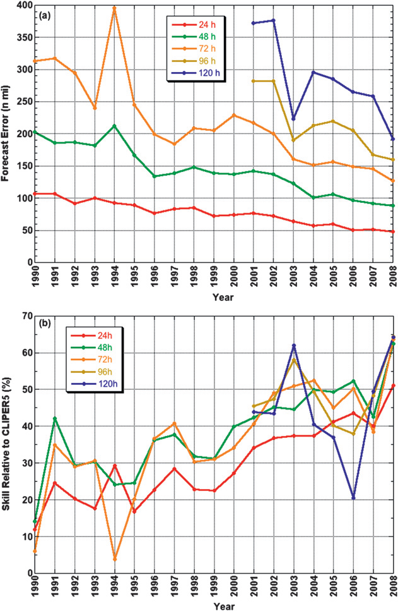
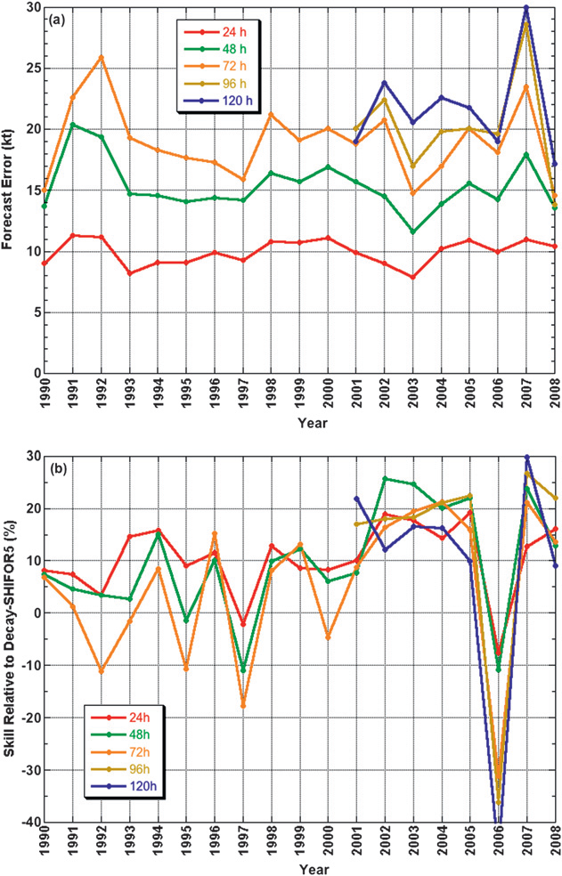
Track and Intensity Errors
NHC Track Error and Skill
NHC Intensity Error and Skill
Rappaport et al. (2009)

Slide 49
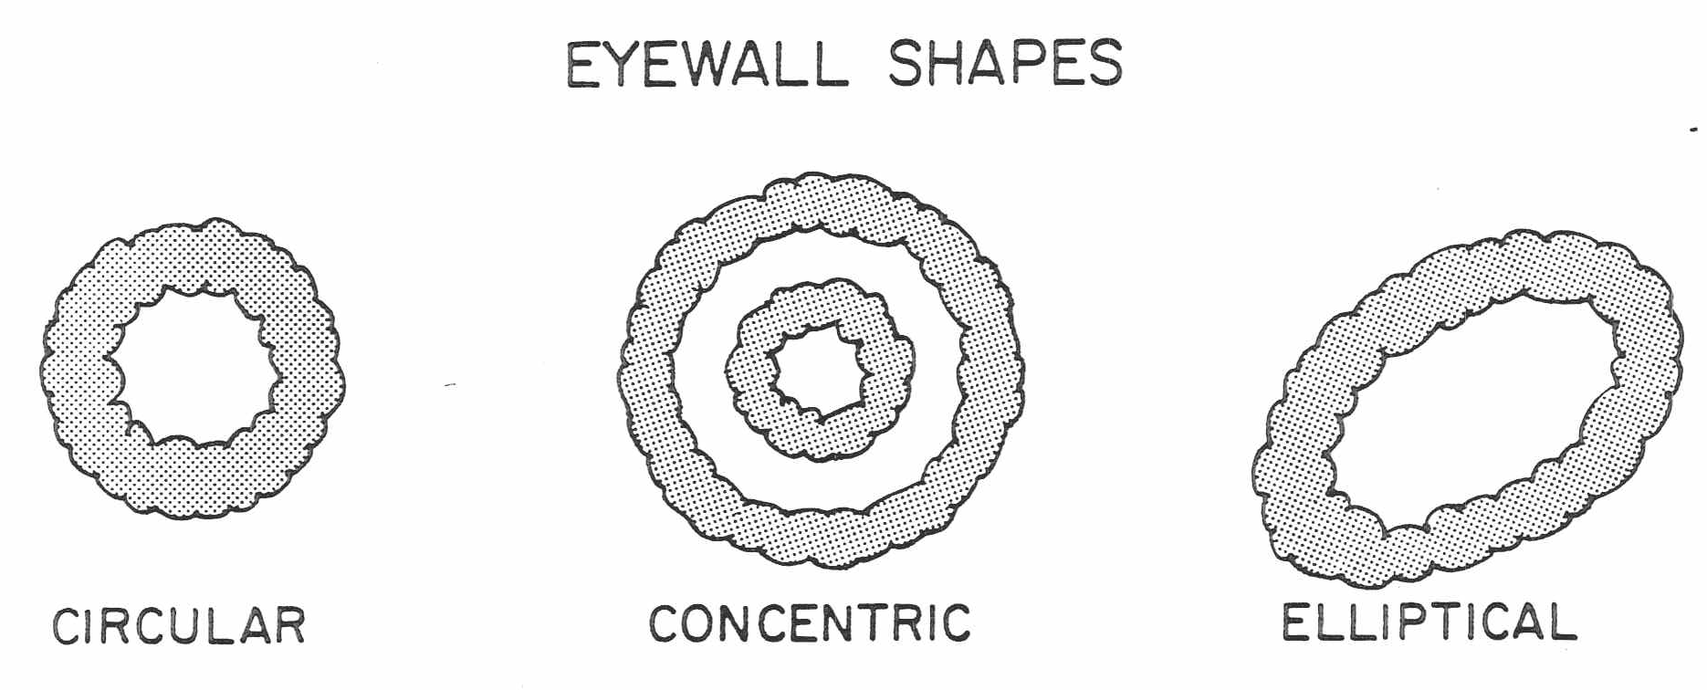
Eye Types
Weatherford (1989)

Slide 50
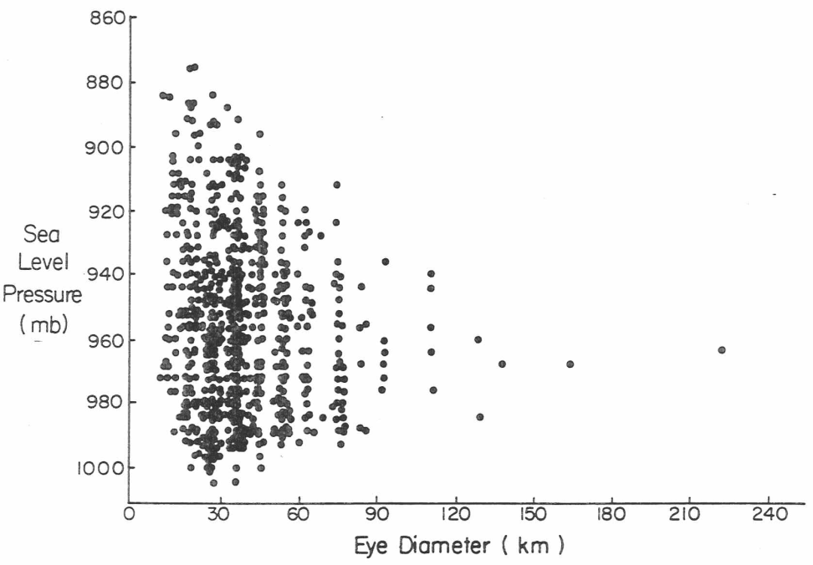
Eye Diameter and Intensity
Weatherford (1989)

Slide 51
Eye Diameter and Intensity

Slide 52
Eye Diameter through Lifecycle

Slide 53
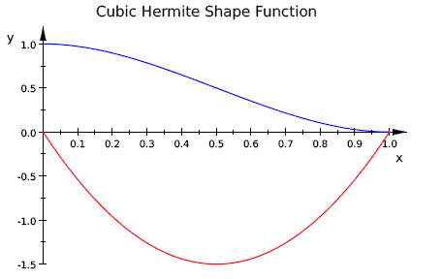
Cubic Hermite Shape Function

Slide 54
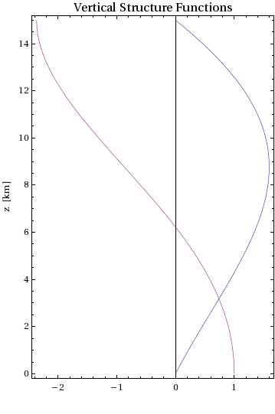
Vertical Structure Functions
Blue curve:
Red curve:

Slide 55
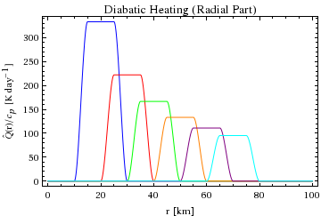
Diabatic Heating Profiles
Diabatic heating was set to be fixed over the domain, so the magnitude of maximum heating was determined by the size of the ring

Slide 56
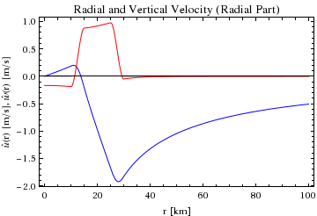
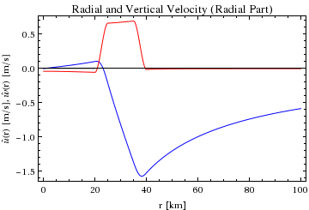
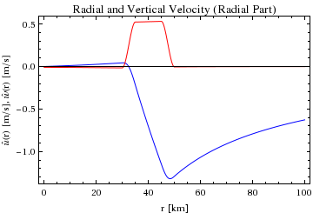
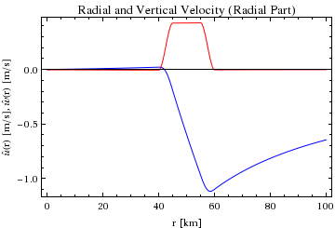
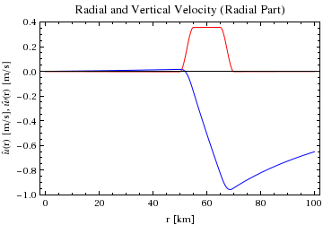
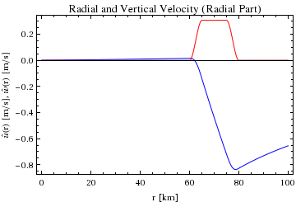
Radial and Vertical Velocity

Slide 57
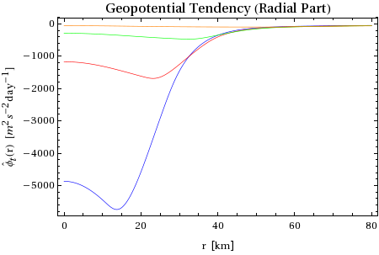
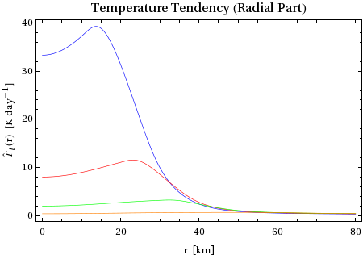
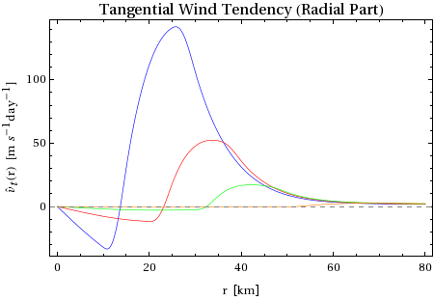
Tendencies

Slide 58
Wilma 2005 Lifecycle V_{max}

Slide 59
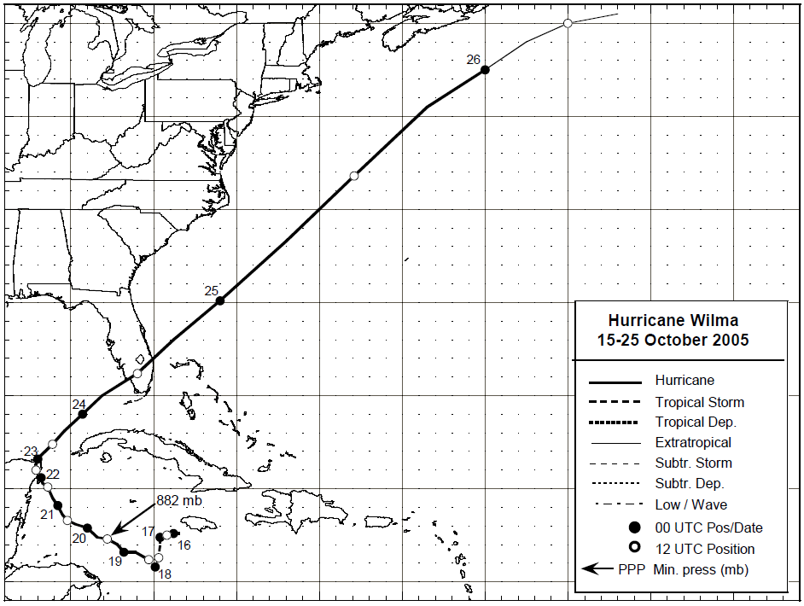
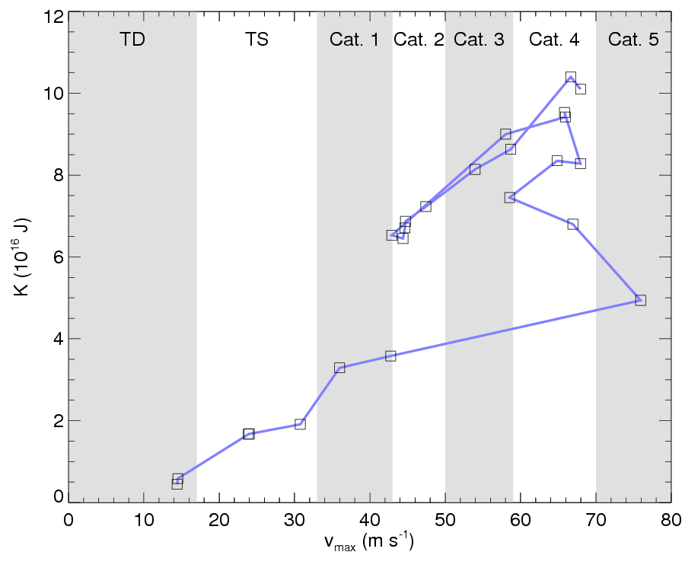
TC Lifecycle: Wilma 2005
10/22
10/23
10/21
10/20
10/18
10/19
10/17

Slide 60
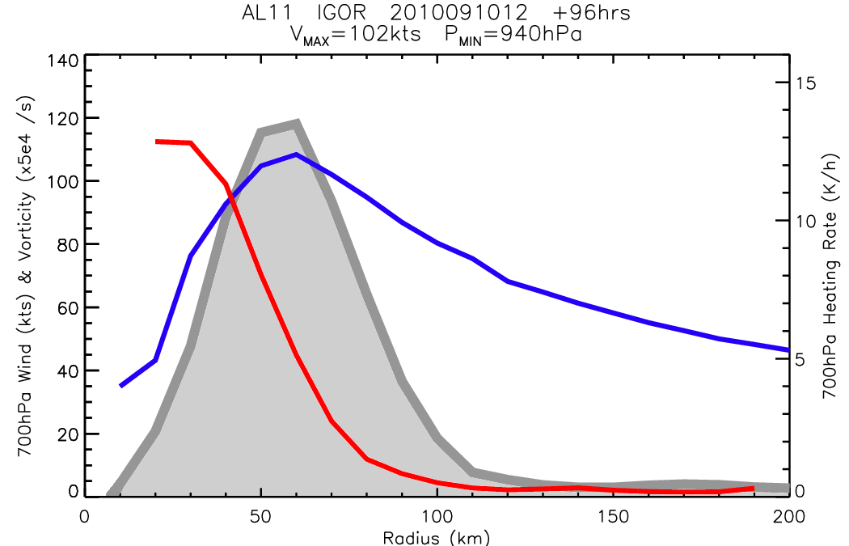
Sample Model Profiles
- HWRF 96h fcst for
Igor from early in life
- Strong heating located
inside vorticity skirt,
and across RMW
- GTE suggests storm
should intensify and
expand based on
these profiles…
- V_{max} increased by 20kt,
RMW increased by 9km,
and R34 increased by 15%
in next 12hr
Heating
Wind speed
Vorticity

